Slide 1
Welcome to Year 1

Slide 2

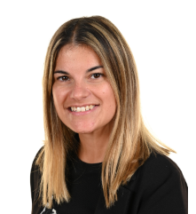

Who will be helping my child?
Mrs Seiler
Mrs Blyth
Tuesday and Wednesday
Mrs Guiver
Thursday and Friday
Maths
English
Phonics
Science
Art/DT
PE
Maths
Re
Geography
History
Computing
PE

Slide 3
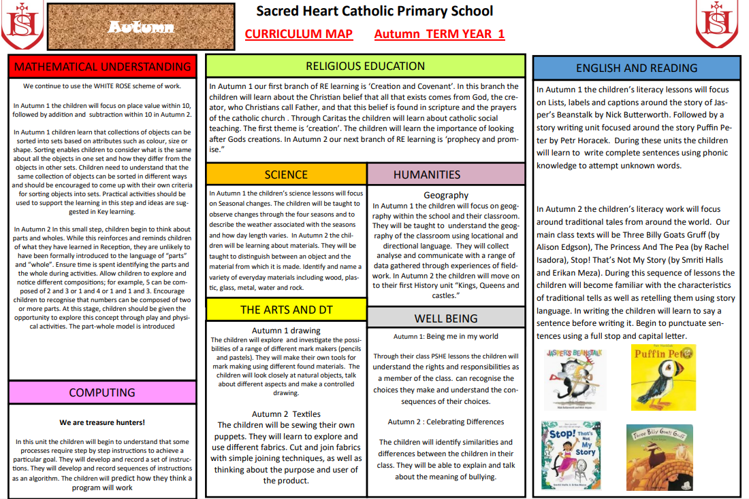
What do I do if I need to speak to a teacher?
Reading record and weekly diary
Contact the office by phone or email (admin@sacredheart312.herts.sch.uk)
Request a meeting for the end of a day
For information about what your child will be learning please refer to the following on the school website:
Curriculum letter
Termly overview
Yearly overview
https://www.sacredheart312.herts.sch.uk/class-pages-1/

Slide 4
What will my child do each day?
This will be built up through out Autumn 1 with a mixture of small group, 1:1 and whole class teach
PE days are Monday and Tuesday.

Slide 5
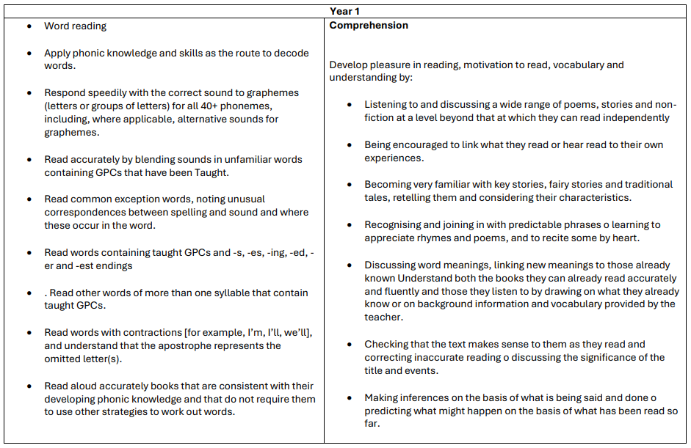
What will my child be learning in English?
National
Expectation

Slide 6
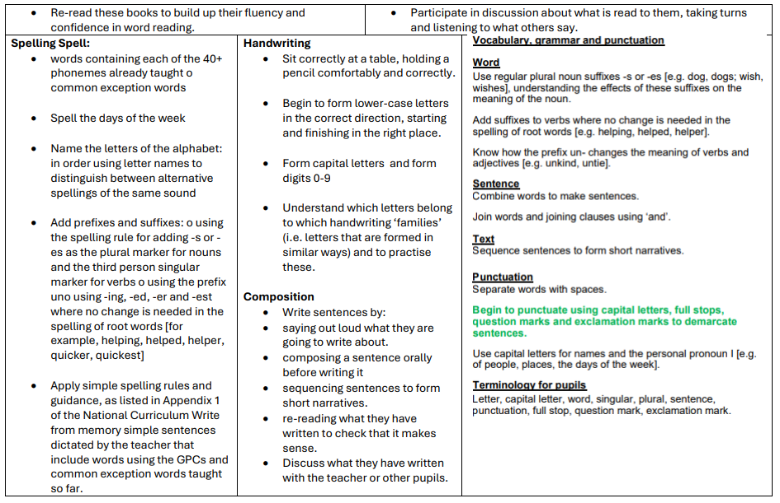

Slide 7
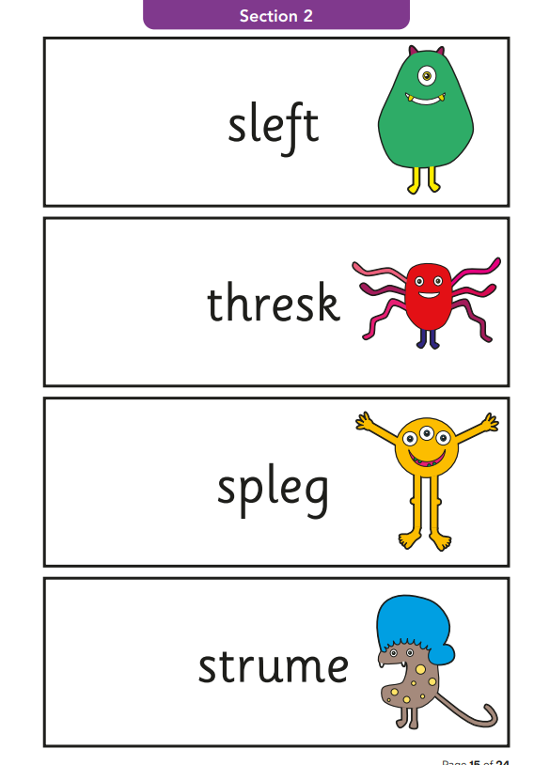
Will my child still have daily phonics lessons?
Phonics parent workshop: 8th October 2:30pm
Children will continue daily phonics sessions. ( This will increase to twice a day for 15 minutes).
If we identify your child needs additional adult support, you will be informed on how we will support them.
The Phonics Screening Check is a national assessment for Year 1 pupils in England.
Carried out annually in June
To support the teacher's assessment to ensure they are secure decoding to an
appropriate standard.
The check involves a child reading 40 words, a mix of real words and pseudo-words (nonsense words)
Taken with the class teacher.
Across the week commencing
Monday 14th June 2027.

Slide 8
Reading
Each child will read with an adult at least once a week. (This is recorded in school) We will focus on improving decoding skills, fluency and comprehension skills.
Your child will be given a book appropriate for their reading level and understanding. This will be changed weekly.
In order for your child to develop fluency and improve all reading skills they must be read with at home every day. Please record comments in the reading record.
Children will visit the school library and will choose a reading book to develop pleasure for reading.

Slide 9
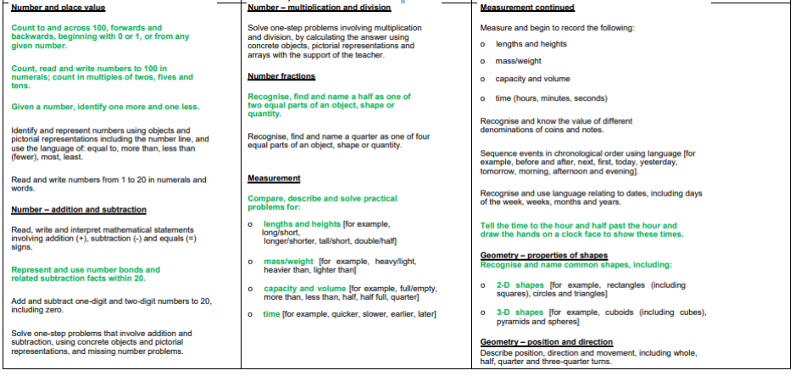
Maths and Maths fluency

Slide 10


Autumn 1
RE: Creation (God the creator)
English - List labels and captions (writing to inform) followed by Narrative (writing to entertain).
Maths – Place value within 10 (Accurate counting, number formation, ordering numbers to ten and
Comparing amounts up to 10)
Science – Seasons and weather (Naming the seasons and describing the differences between them)
Geography – What is it like here?
Computing – We are treasure hunters. (To program a toy to follow their algorithm.)
Art: Drawing
PE: Dance and Ball skills
PSHE being in my world
Assessment

Slide 11



Autumn 2
RE – Jesus and the Annunciation
English - Narrative (Traditional Tales): Three Billy Goats Gruff (by Alison Edgson), The Princess And The Pea (by Rachel Isadora), Stop! That’s Not My Story (by Smriti Halls and Erikan Meza).
Recipes: Gruffalo Crumble (by Julia Donaldson)
Maths: Addition and Subtraction within ten (Looking at how parts make a whole)
Science: Materials (Name materials and describe their properties)
History: How am I making History?
Computing: To use a video camera to capture moving images.
Design and Technology: Food (design and make a smoothie)
Pe: Bats and balls / Gymnastics
PSHE: Celebrating differences

Slide 12


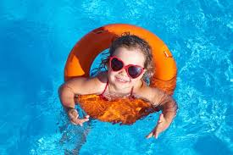
Spring 1
RE – Galilee to Jerusalem (Jesus’ ministry)
English - Narrative: Stanley’s Stick (by John Hegley)
Poetry: range of nursery rhymes Oi Frog (by Kes Gray & Jim Field) Recount :Ravi’s Roar Ruby’s Worry
Maths: Place value within 20 (Tens and ones), Addition and subtraction within 20.
Science: Materials continues (Name materials and describe their properties)
Geography: What is the weather like in the UK?
Computing: We are painters (To use the web safely to find ideas for illustration)
Art: Painting
Pe: Bats and balls/ Gymnastics
PSHE: Healthy me

Slide 13
Spring 2
Trip: Hertford Museum
RE – Desert to Garden (Lent and holy week)
English -Short narrative (based on real experiences): Madlenka (by Peter Sis), Poetry: Take One Poet Julia Donaldson Poems To Perform)
Maths: Place value within 50 (Tens and ones), Measurement (measure and compare lengths in cm)
Science: Animals including humans
History: Toys: then and now.
Computing: We are story tellers (To use sound recording equipment to record sounds.)
Design and Technology: Mechanism: Levers and Sliders
Pe: Ball skills: hands/ Locomotion: Jumping
PSHE: Dreams and Goals (tackling a new challenge)

Slide 14


Summer 1
RE – To the ends of Earth (Pentecost and the ascension)
English - Poetry: A First Book of Poems: Out and About
Narrative: Little Red and the Very Hungry Lion (by Alex T. Smith)
Letters: Paddington’s Post. Here Comes Mr Postmouse Letters to A Monster*
Maths: Multiplication and division (repeated addition), Fractions ( finding halves and quarters of shapes and amounts)
Science: Animals including humans continued
Computing: We are story tellers (To use sound recording equipment to record sounds.)
Pe: Ball Skills : Sticks/ Ball skills: Hands
PSHE: Relationships

Slide 15
Summer 2
RE: Dialogue and Encounter (Look at other faiths)
English: Explanation: The Big Book of Bugs (by Yuval Zommer); The Amazing Life Cycle of Butterflies (by Kay Barnham); Tad (by Benji Davies) Narrative : We’re Going to Find the Monster!
Maths: Place value within 100 and Time ( O’clock and Half past)
Science: Plants
History : How have explorers changed the world?
Computing: We are celebrators (developing keyboard skills)
DT: Textiles (joining materials)
PE: Attack and Defence and team building
PSHE: Changing me

Slide 16
What can I do at home to support my child?
- Mathletics (log ins to be found in the reading record)
Reading daily
Phonics homework (To begin in Autumn 2)
Weekly spellings
Half termly projects
First Project: Show your understanding about weather.
Due: Friday 9th October.

