Slide 1




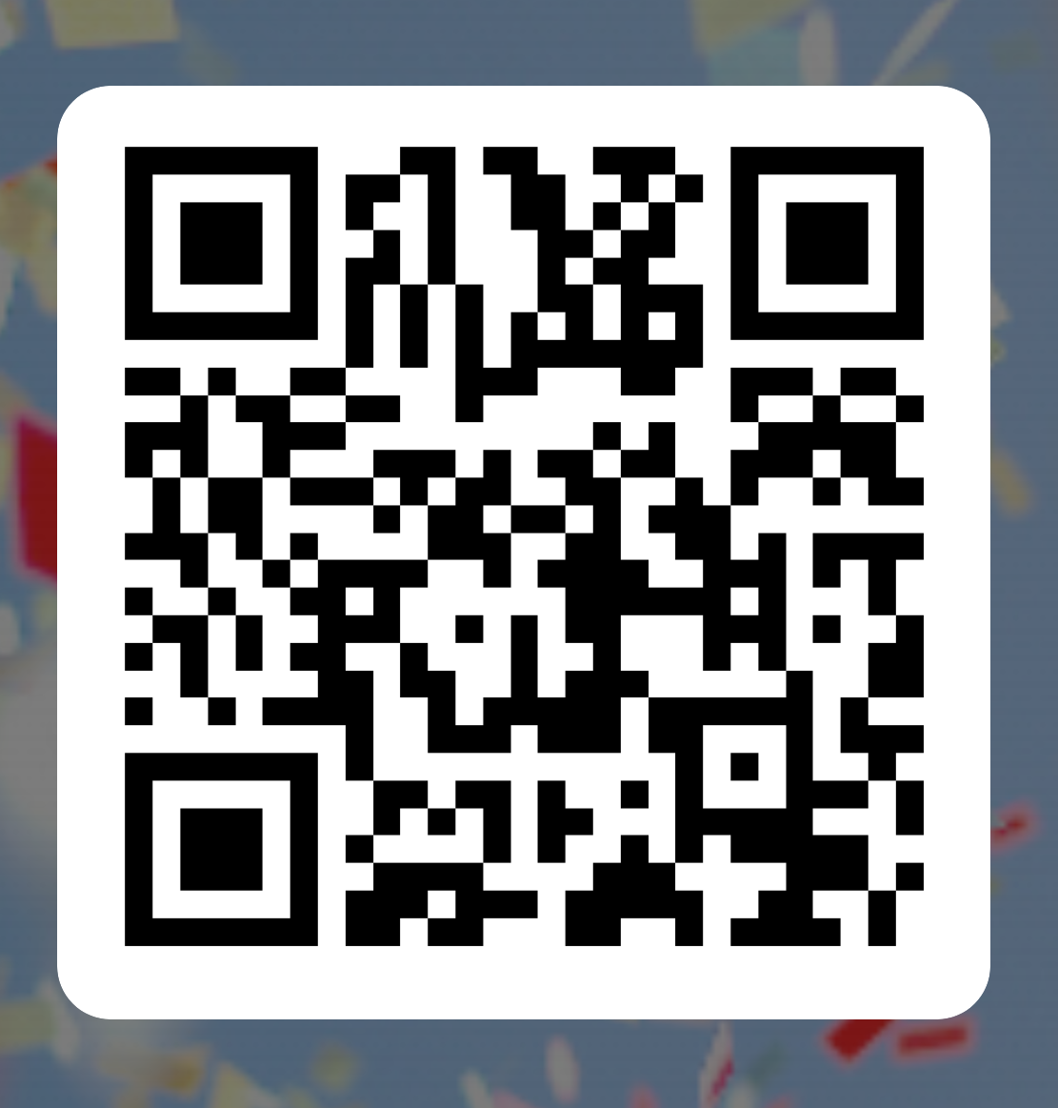


Warriors of Wellbeing
Proudly hosted by
WoW Camp returns :
Monday 27TH July – 1ST August 2026
Simon Balle all through School
WoW camp aims to support children ages 8 - 12 yrs, attending the East Herts Schools in partnership with the MHST . This a free NHS service.
Camp
Improve emotional literacy with qualified mental health & wellbeing practitioners
Understand the importance of mental health and wellbeing
Learn about the “5 Ways of Wellbeing” to promote positive health
Promote positive wellbeing through fun-filled, educational activities
To apply for a place
Scan the QR code or
By 12TH JUNE 2026
Please note – Completing an application does not guarantee a place at WOW Camp
The MHST WOW Camp is NOT a child care service

