Slide 1
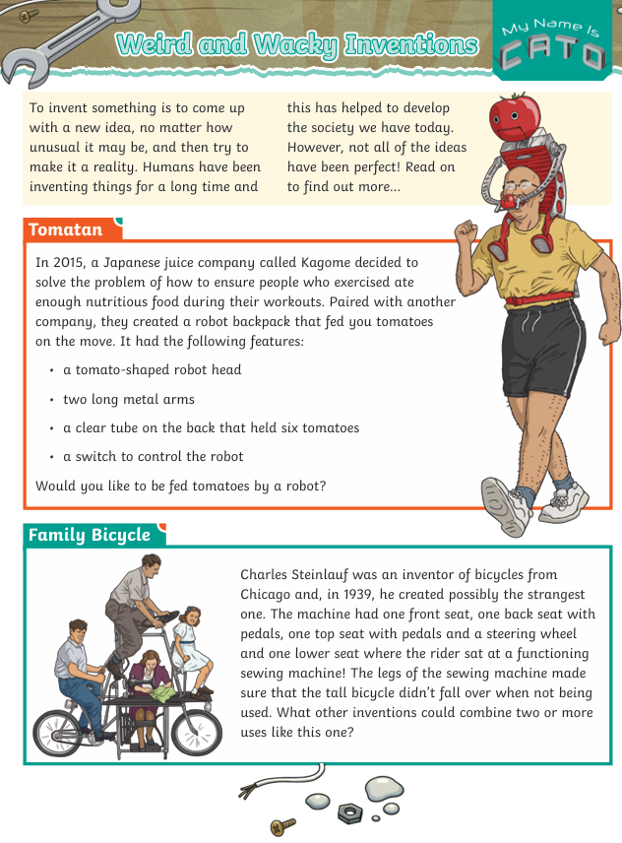
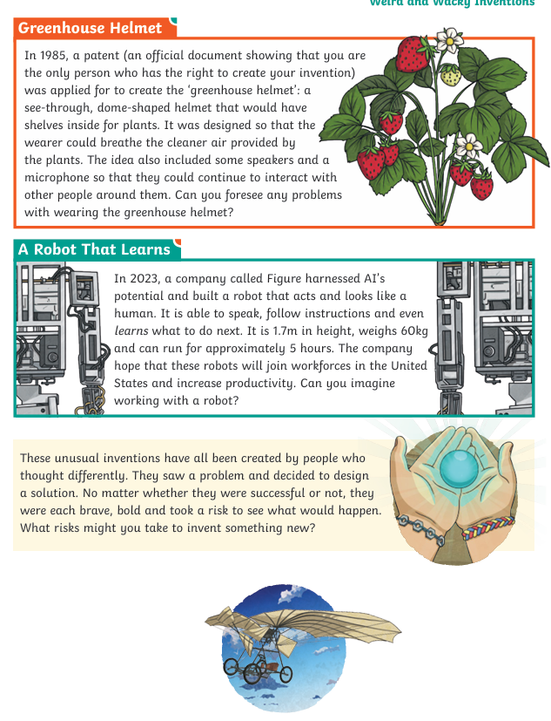

Slide 2
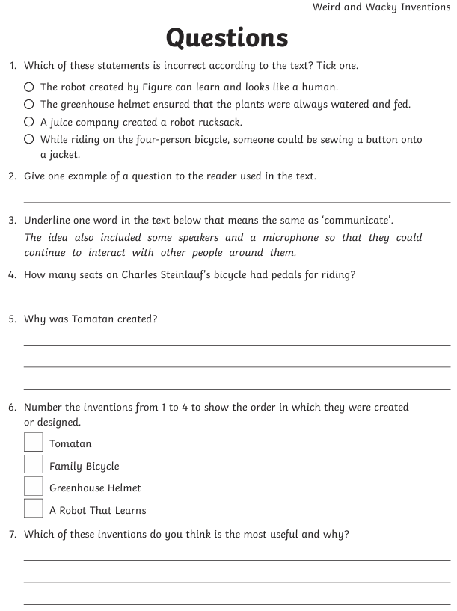
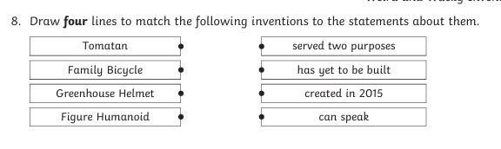
Extra challenge:
Create your own wacky invention.
Draw a clearly, labelled diagram.
What does it do?
How does it work?

