Slide 1
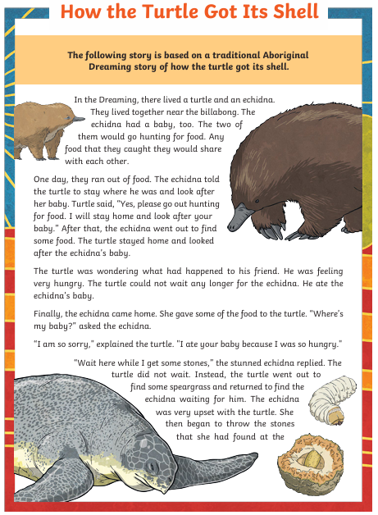
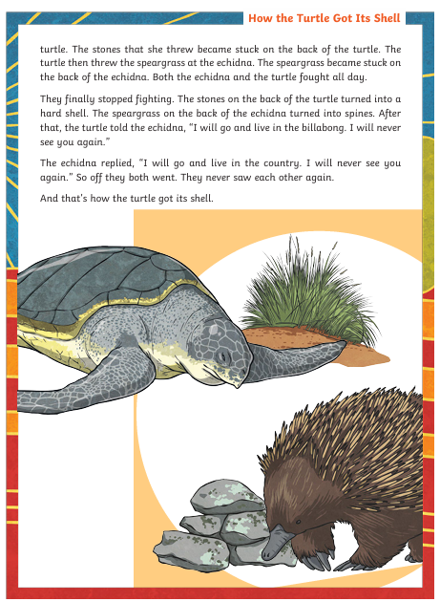

Slide 2
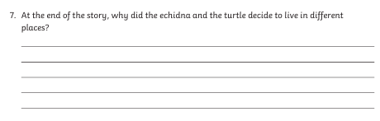
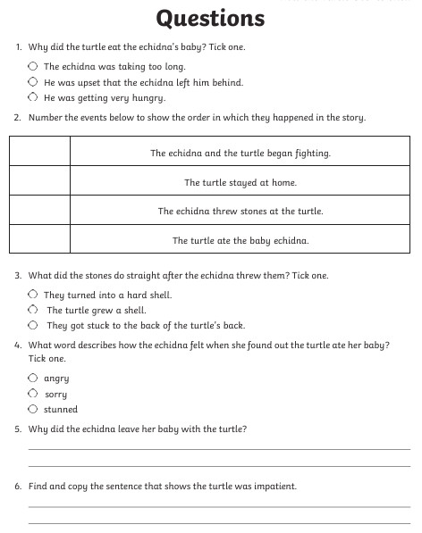
Extra challenge:
Write your own short story on the theme of ‘How the _____ got its____’
Maybe how the rhino got its horn or how the leopard got its spots. You decide.

