Slide 1
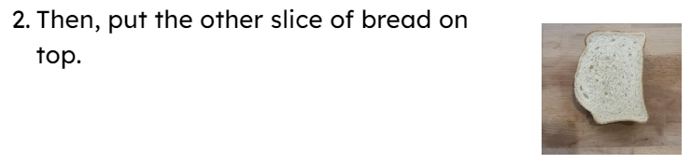

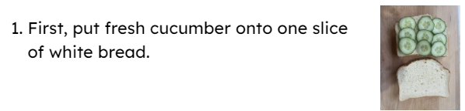
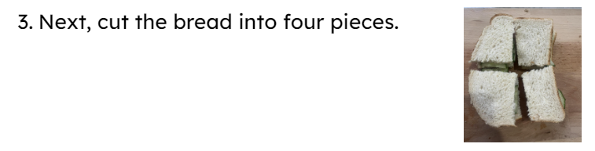
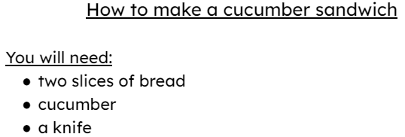
Following instructions to make a sandwich
Task A: Sequencing and reading instructions
Put the instructions into the correct order. Read them back to check.

Slide 2

Task B: Making a sandwich
Following instructions to make a sandwich
Discuss: Think and share your answers to these questions.
What was your favourite part of making the sandwich?
My favourite part was … because … .
What made the instructions easy to follow?
… and … made the instructions easy to follow.
Fox Federation
v2.5

