Slide 1


Slide 3

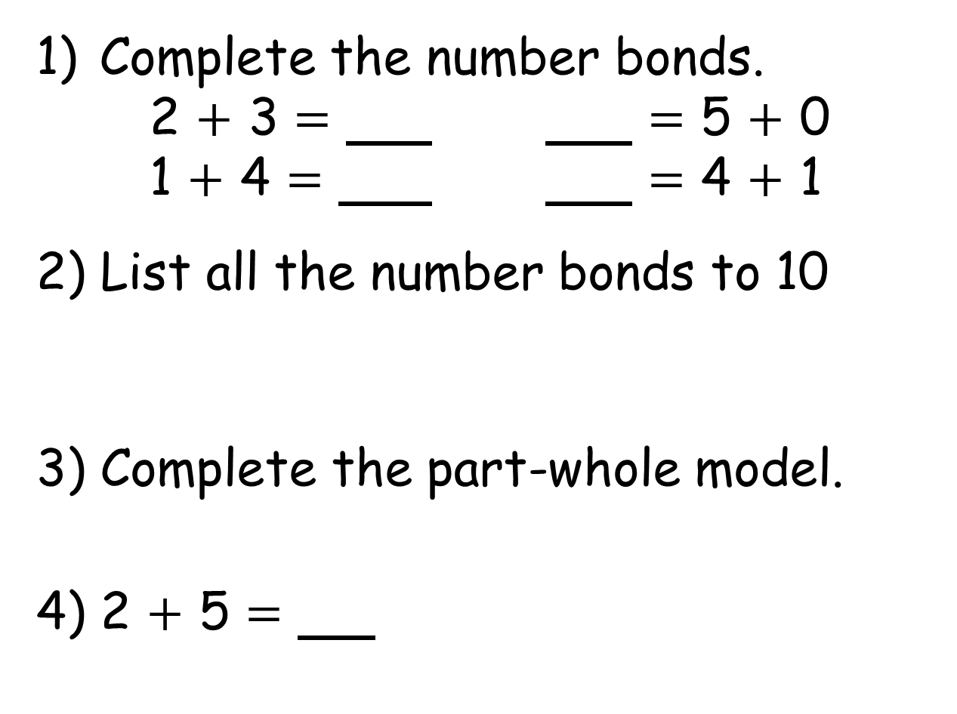
Complete the number bonds.
2 $+$ 3 $=$ $=$ 5 $+$ 0
1 $+$ 4 $=$ $=$ 4 $+$ 1
2) List all the number bonds to 10
3) Complete the part-whole model.
4) 2 $+$ 5 $=$
5
4

Slide 4
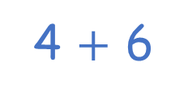
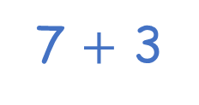
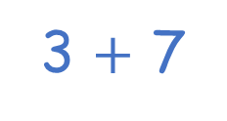
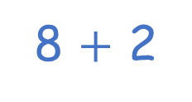
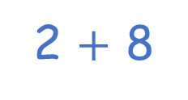
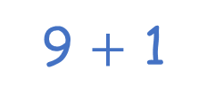
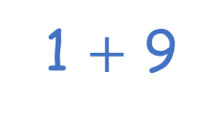
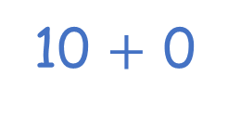
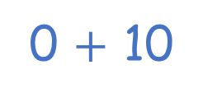
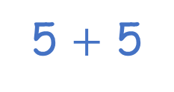
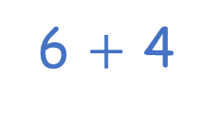
Complete the number bonds.
2 $+$ 3 $=$ $=$ 5 $+$ 0
1 $+$ 4 $=$ $=$ 4 $+$ 1
2) List all the number bonds to 10
3) Complete the part-whole model.
4) 2 $+$ 5 $=$
5
5
5
5
0 $+$ 10
1 $+$ 9
2 $+$ 8
3 $+$ 7
4 $+$ 6
5 $+$ 5
10 $+$ 0
9 $+$ 1
8 $+$ 2
7 $+$ 3
6 $+$ 4
9
7
5
4

Slide 6
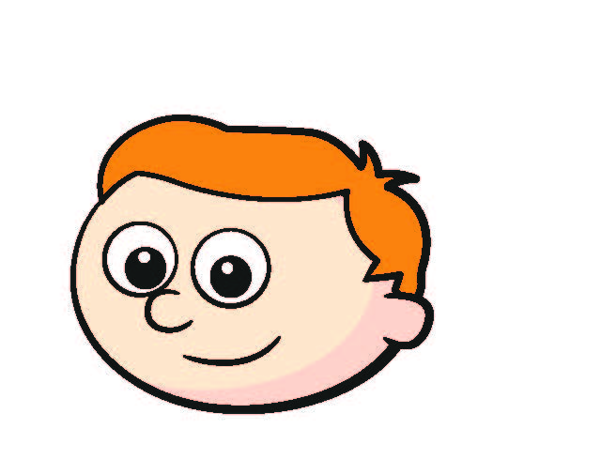

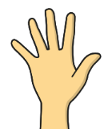



Ron has 5 pennies.
How many pennies are
in Ron’s closed hand?
1 penny
5
If the whole is and is a part, then the other part is
4
1
4
$$+$$
1
$$=$$
5

Slide 7



Ron has 5 pennies.
How many pennies are
in Ron’s closed hand?
3 pennies
5
If the whole is and is a part, then the other part is
2
3
2
$$+$$
3
$$=$$
5
Have a think

Slide 8



Collect 10 counters.
Put some counters in both hands.
Close one of your hands.
Can your partner work out how many are in the closed hand?
10
10
If the whole is and is a part, then the other part is
6
4
6
4
6
$$+$$
4
$$=$$
10

Slide 9
Collect 10 counters.
Put some counters in both hands.
Close one of your hands.
Can your partner work out how many are in the closed hand?
10
If the whole is and is a part, then the other part is
3
3
$$+$$
$$=$$
10

Slide 10


There are seven children in a classroom.
Two of the children are wearing glasses.
How many are not wearing glasses?
5 children
7
7
2
5
The bond to for is
2
5
2
$$+$$
5
$$=$$
7

Slide 11
There are some red and green apples in a bag.
Five of the apples are red.
There are nine apples in total.
How many of the apples are green?
4 green apples
9
9
5
4
The bond to for is
5
4
5
$$+$$
4
$$=$$
9
Have a think

Slide 12
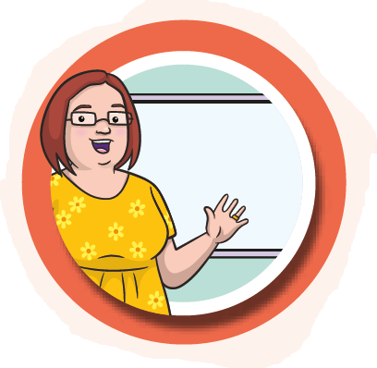
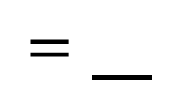

If 4 is a part, how can the
part-whole model be completed?
0
1
2
3
4
5
6
7
8
9
4
$$+$$
$=$
3
7

Slide 13

If 4 is a part, how can the part-whole model be completed?
0
1
2
3
5
6
7
8
9
4
$$+$$
$$=$$
4

Slide 14
Are there any numbers you could not use? Why?
What if 6 is a part?
0
1
2
3
4
5
6
7
8
9
$$+$$
$$=$$

Slide 15
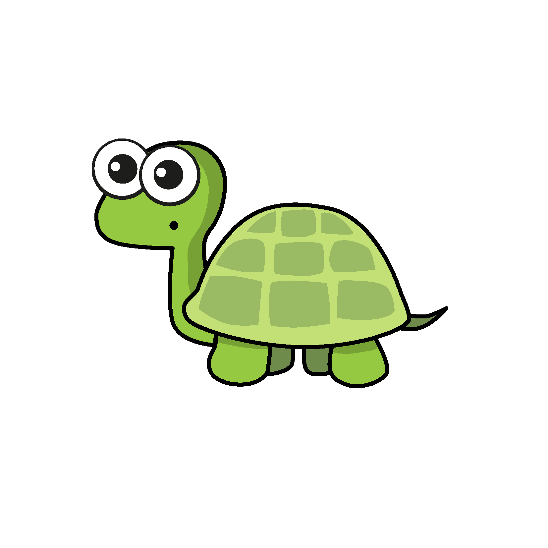


Tiny is thinking of a number.
4 more than my number is 6
What number is Tiny thinking of?
2
6
4
2
The bond to for is
4
$$+$$
2
$$=$$
6

Slide 16



Slide 17
Have a go at questions

Slide 18
I do
You do

Slide 19
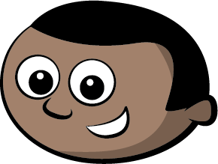

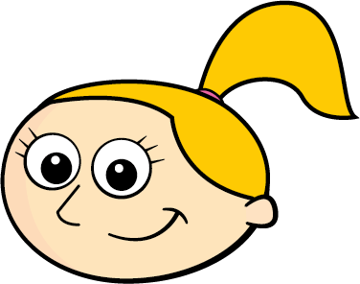

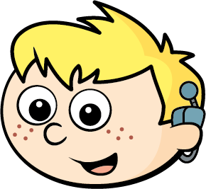




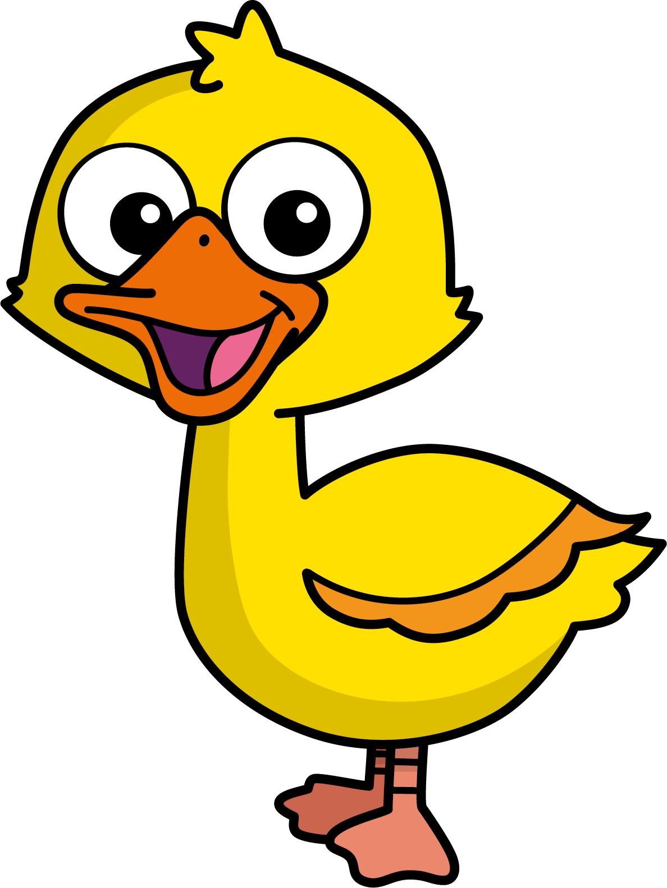
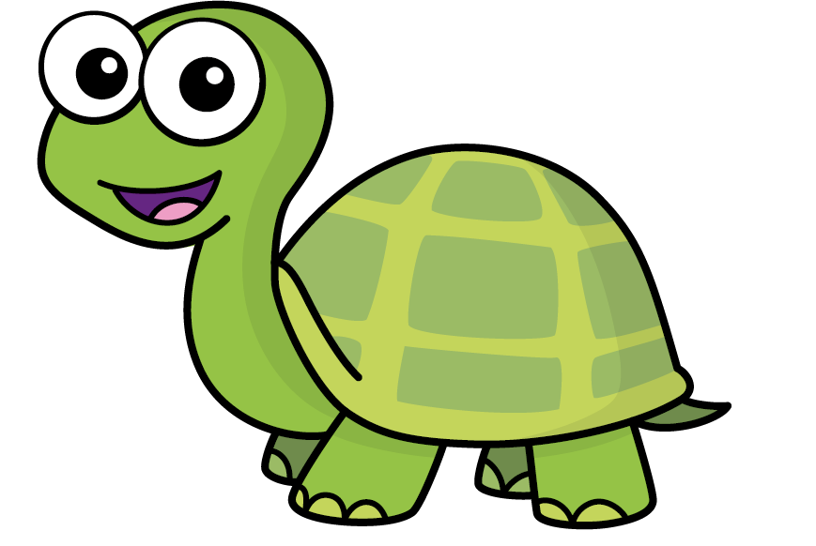
Mo
Jack
Eva
Ron
Max
Kim
Jo
Sam
Speech bubble text
Bee
Diddy
Tiny

Slide 20







T | O
H | T | O
100
40 | 60

Slide 21
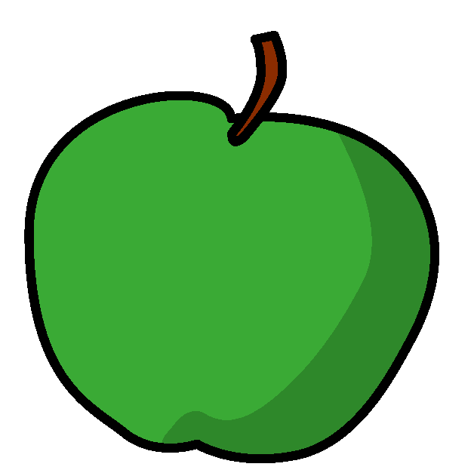

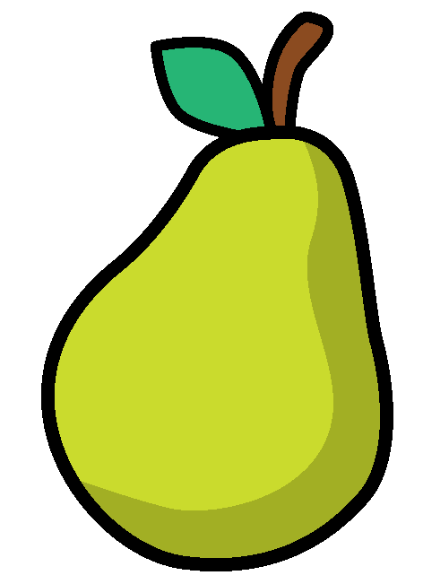
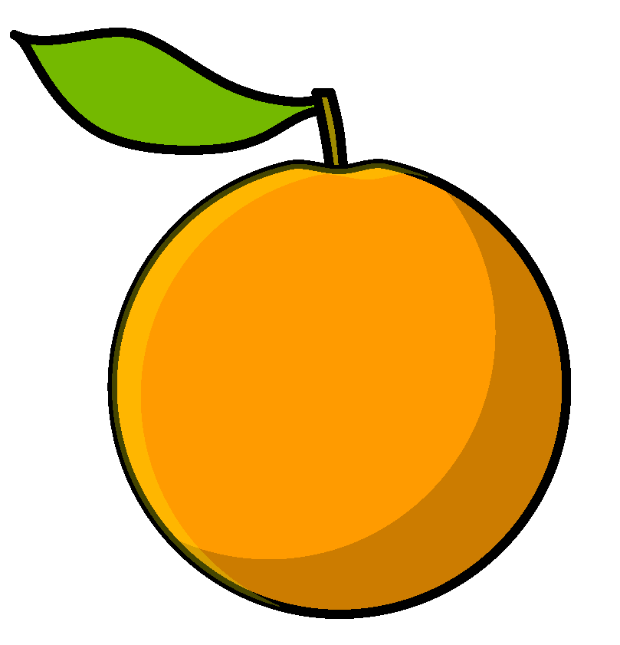

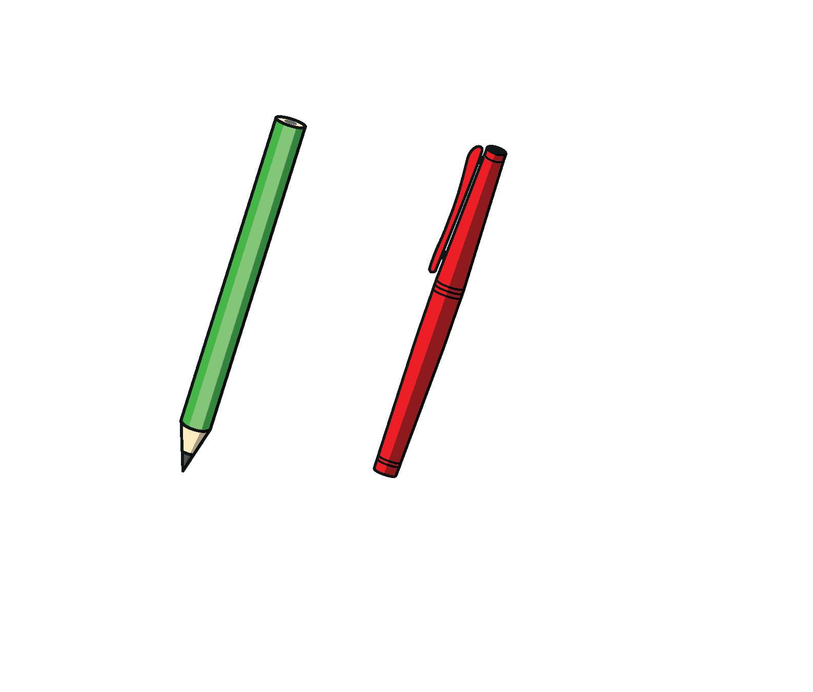
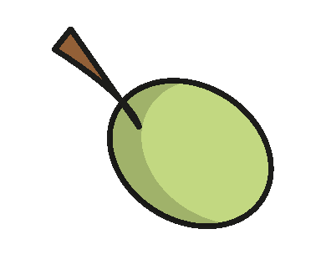
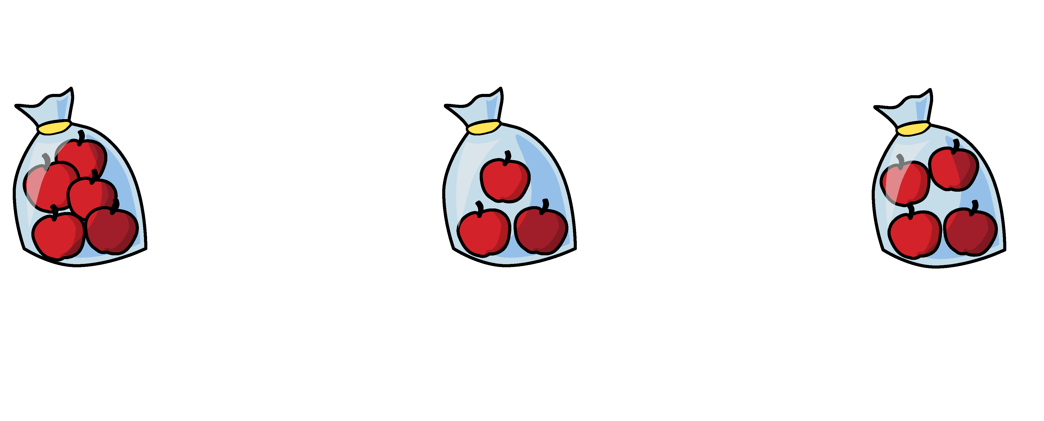


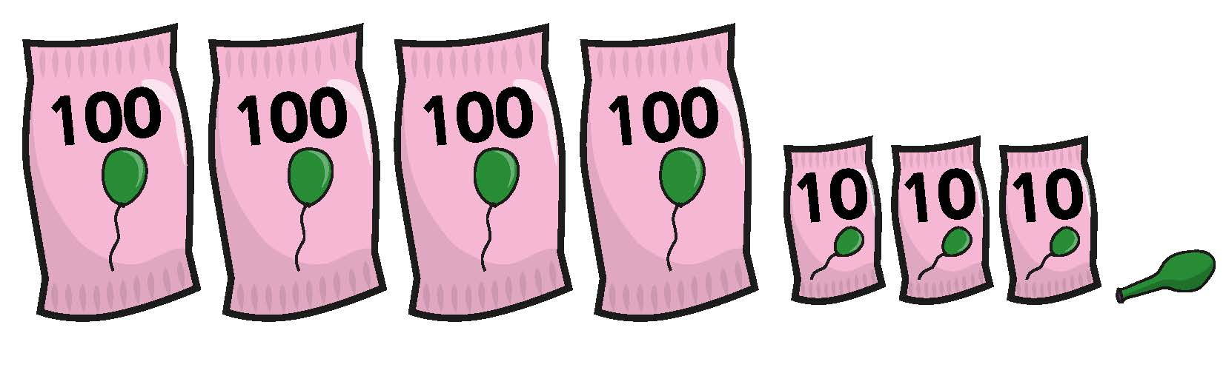

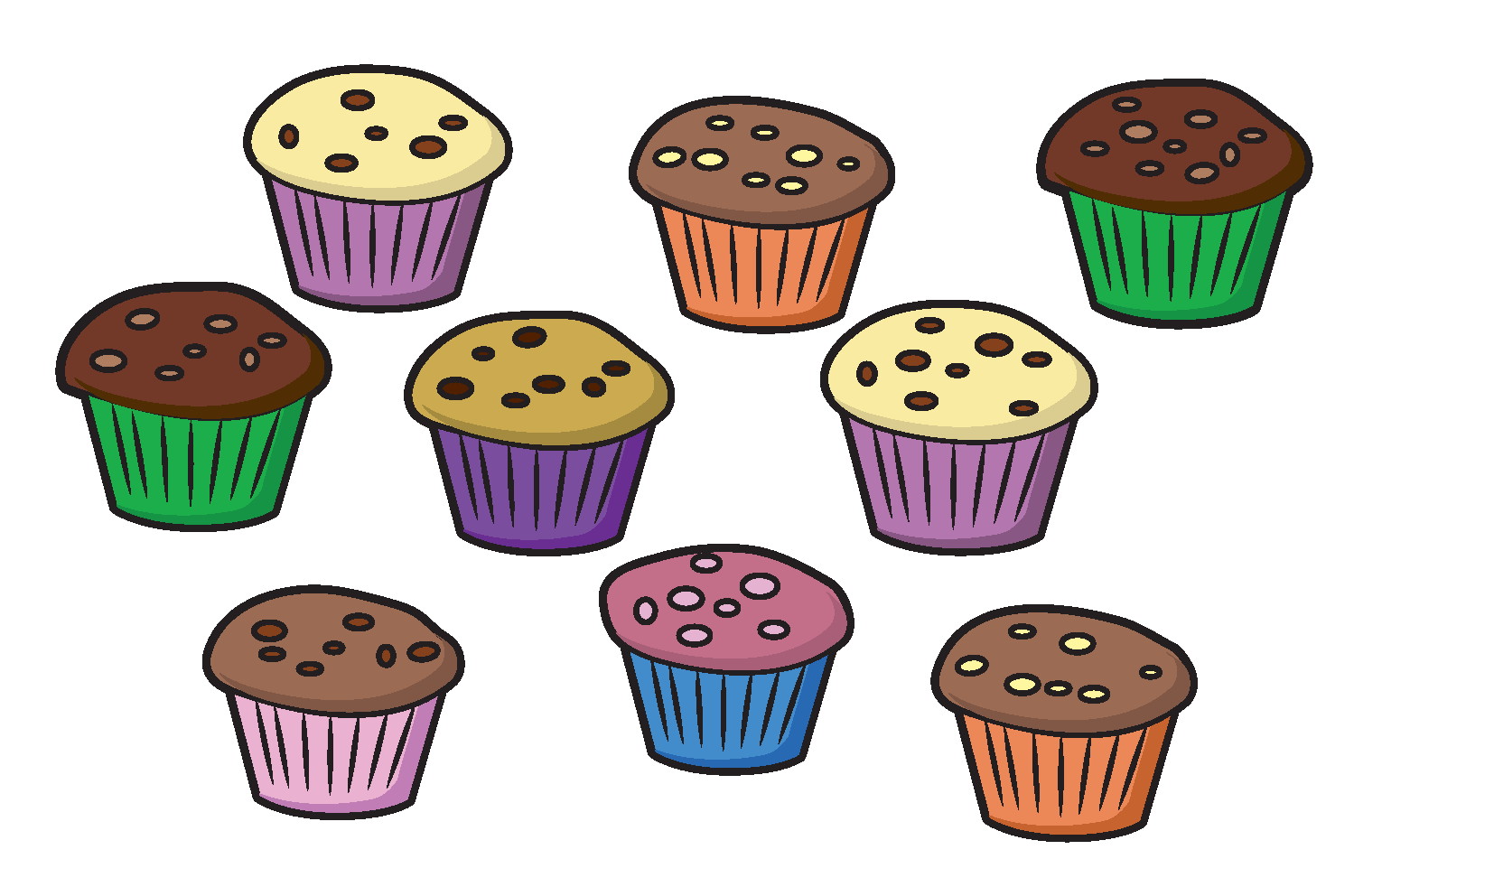
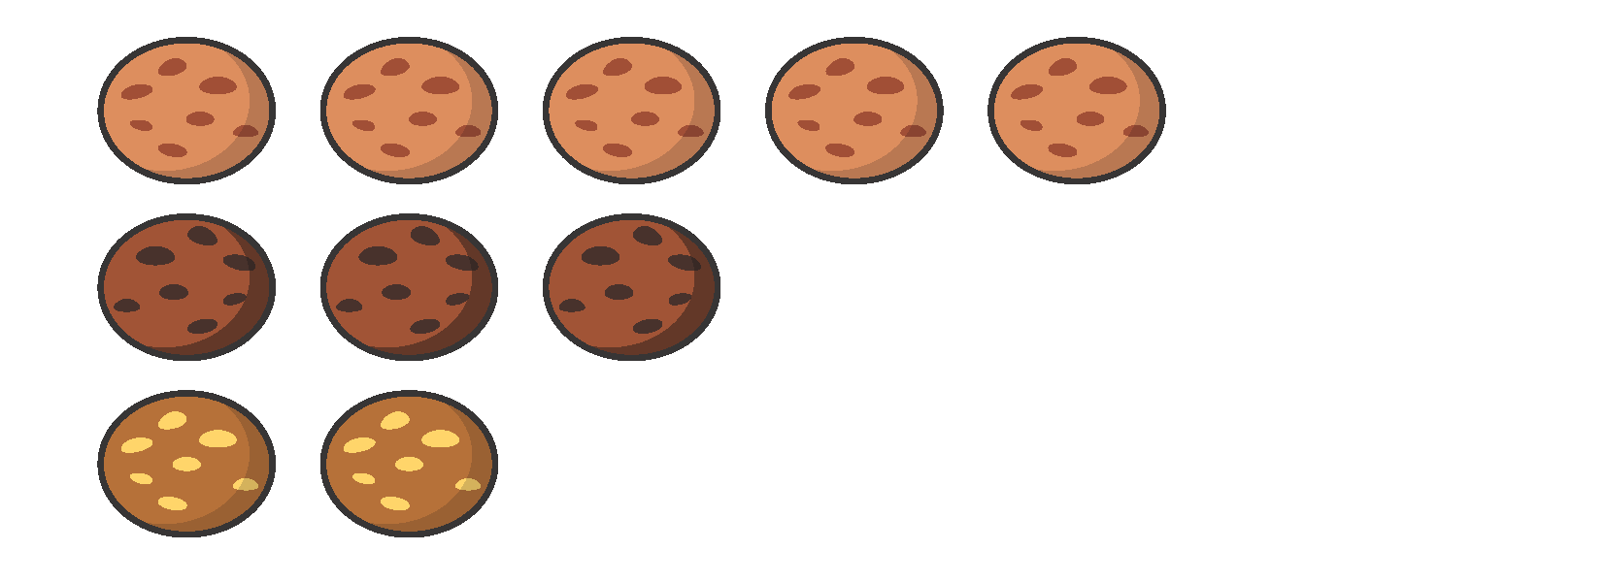
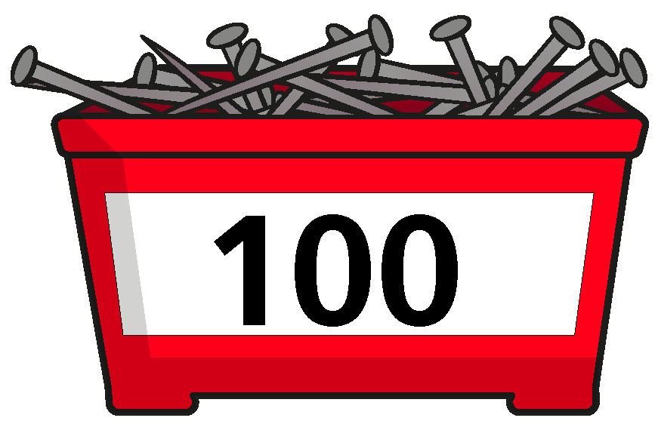
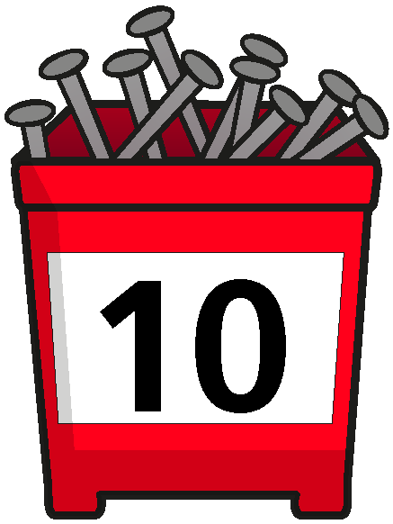

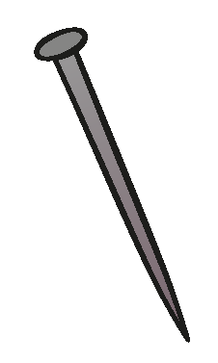








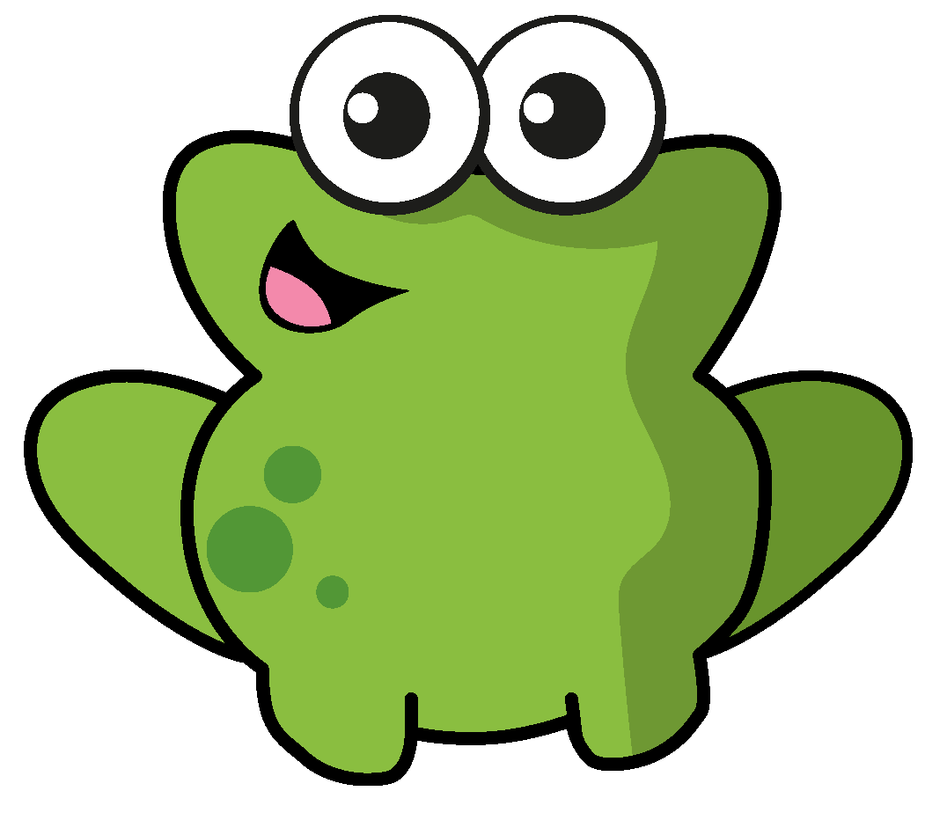
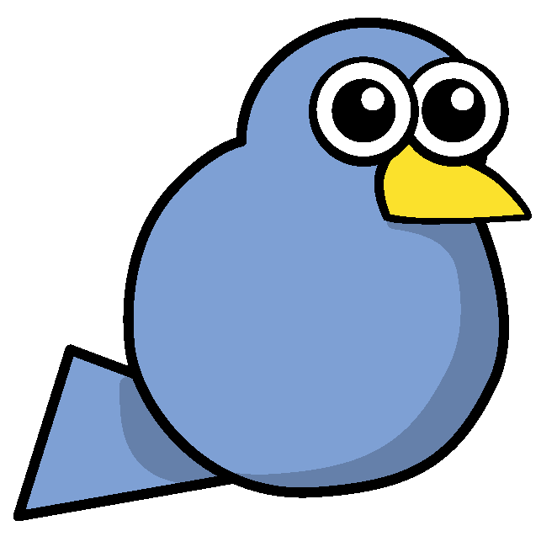
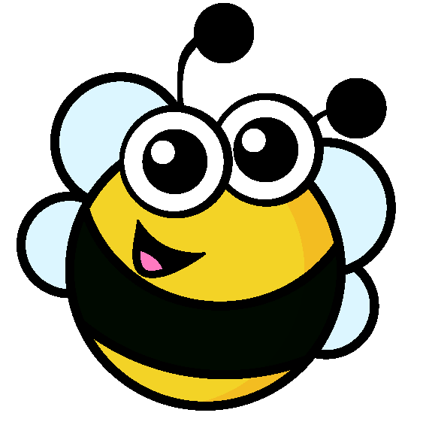




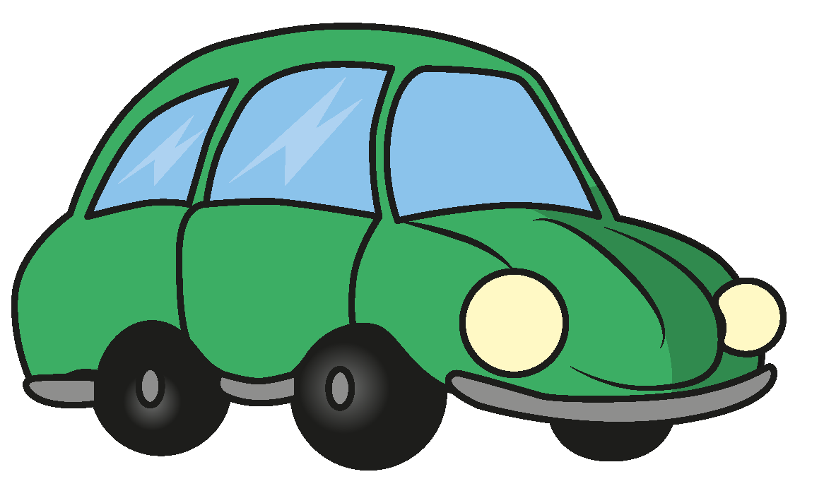
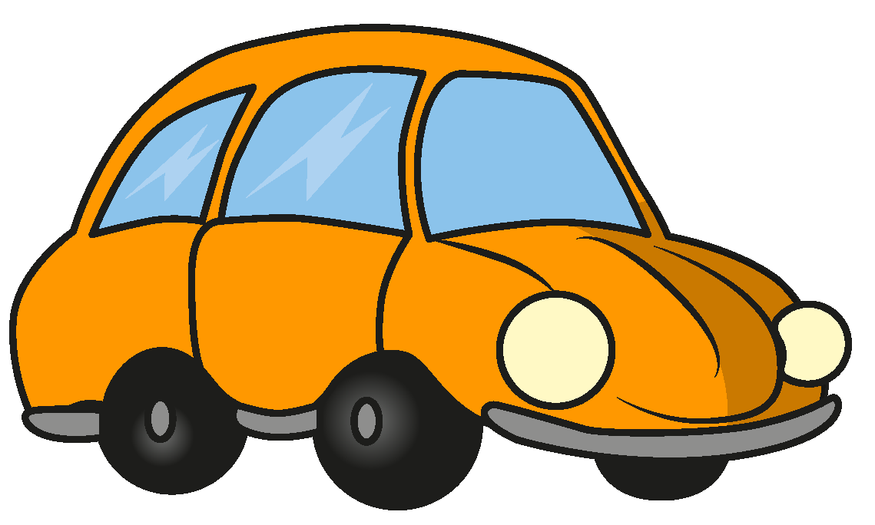




Slide 22



































