Slide 1

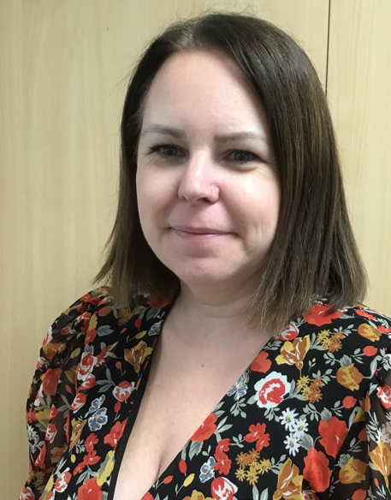
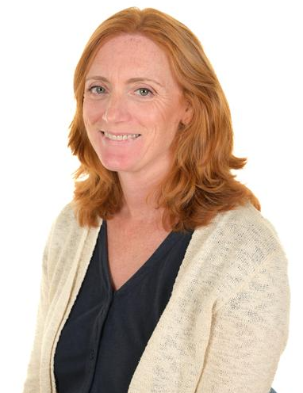
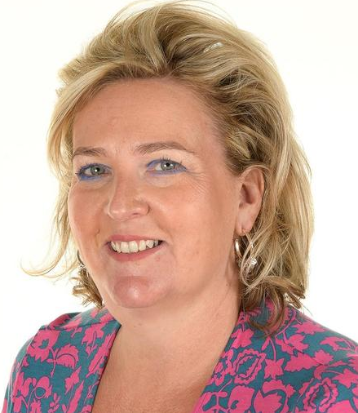
Early Years Foundation Stage
We would like to take the opportunity to welcome you and your child to our class.
Mrs Gupta Mrs Schertel Mrs Seiler

Slide 2
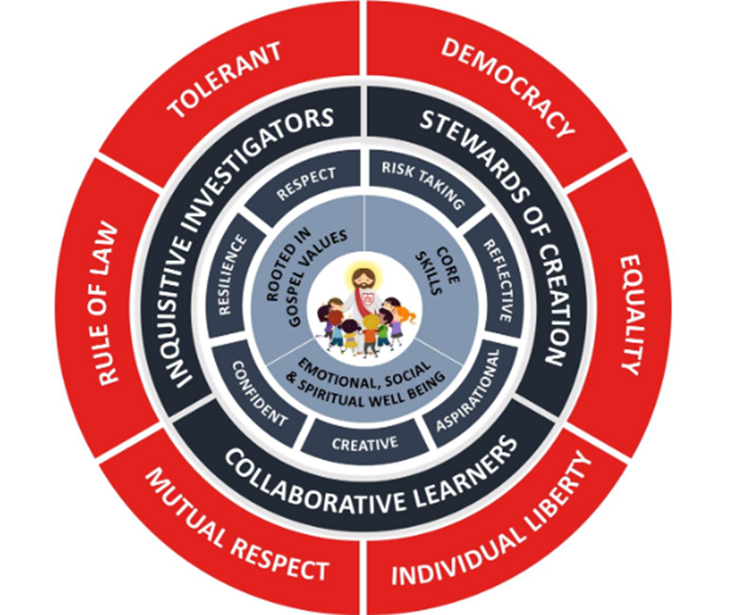
The Curriculum wheel
At Sacred Heart Jesus is at the centre of everything. These themes are threaded throughout our curriculum. It starts in reception and goes up to year 6.
Notes:
At Sacred Heart Jesus is at the centre of everything. These themes are threaded throughout our curriculum. It starts in reception and goes up to year 6.

Slide 3







Our Learning Powers
Aspirational
Reflective
Risk-taking
Confident
Resilient
Creative
Respect

Slide 4
The Early Years Curriculum
In Early Years, there are seven areas of learning:
Area of Learning and Development | Aspect
Prime areas
Communication and Language (C&L) | Listening, Attention and Understanding
 | Speaking
Personal, Social and Emotional Development (PSED) | Self-Regulation
 | Managing Self
 | Building Relationships
Physical Development | Gross Motor Skills
 | Fine Motor Skills
Specific areas
Literacy | Comprehension
 | Word Reading
 | Writing
Mathematics | Number
 | Numerical Patterns
Understanding the World (UW) | Past and Present
 | People, Culture and Communities
 | The Natural World
Expressive Arts and Design (EAD) | Creating with Materials
 | Being Imaginative and Expressive
Our first topic is ‘All about me’.
As we get to know the children, we will base our topics around their interests.
For more information about teaching and learning for this half term, please see the curriculum letter on our website page.

Slide 5
What are we working towards?
By the end of Reception, we aim for children to achieve the Early Learning Goal for each area of learning.
Statutory Framework for the Early Years Foundation Stage
This link will take you to the official Early Years objectives document.
Development Matters- Non-Statutory Curriculum Guidance This will take you to a booklet which outlines Early learning objectives for each age stage.

Slide 6
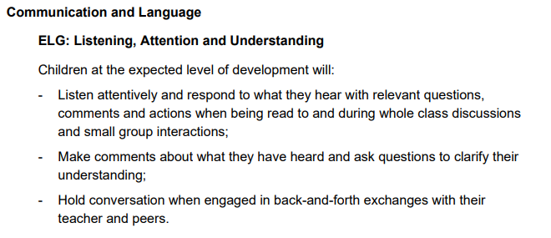
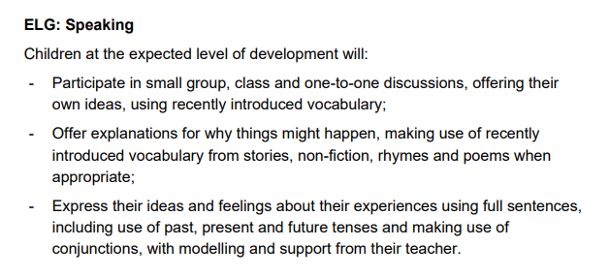
Communication and Language
“The development of children’s spoken language underpins all seven areas of learning and development.”
- Statutory Framework for the Early Years Foundation Stage, 2021

Slide 7
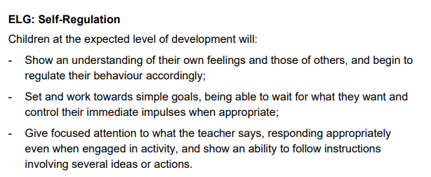
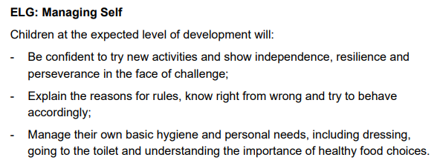
Personal, Social and Emotional Development
“Children’s personal, social and emotional development (PSED) is crucial for children to lead healthy and happy lives, and is fundamental to their cognitive development.”
- Statutory Framework for the Early Years Foundation Stage, 2021

Slide 8
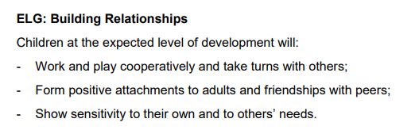

Slide 9
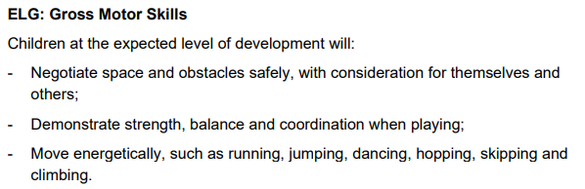
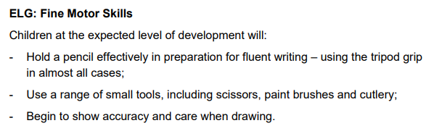
Physical Development
“Physical activity is vital in children’s all-round development, enabling them to pursue happy, healthy and active lives.”
- Statutory Framework for the Early Years Foundation Stage, 2021

Slide 10
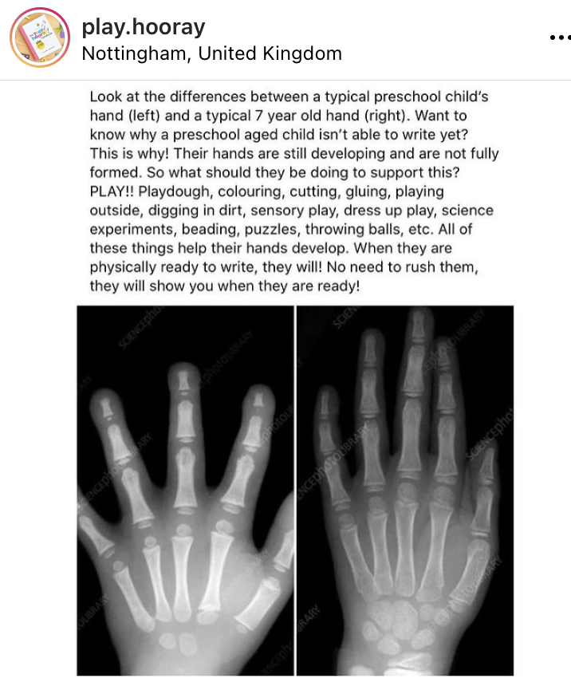
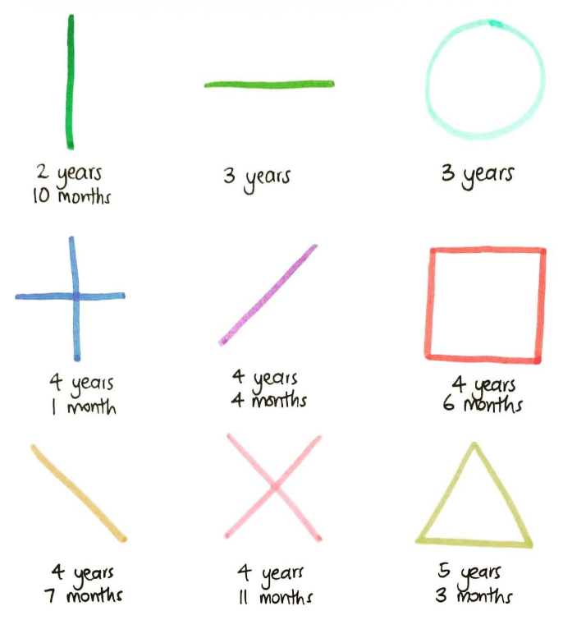
Why?

Slide 11
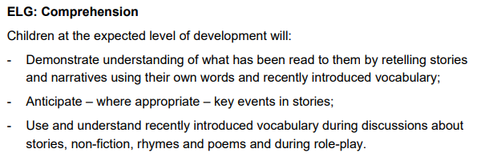
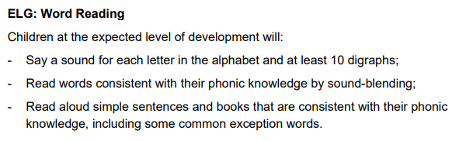
Literacy
“It is crucial for children to develop a life-long love of reading.”
- Statutory Framework for the Early Years Foundation Stage, 2021

Slide 12
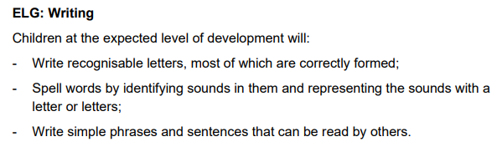
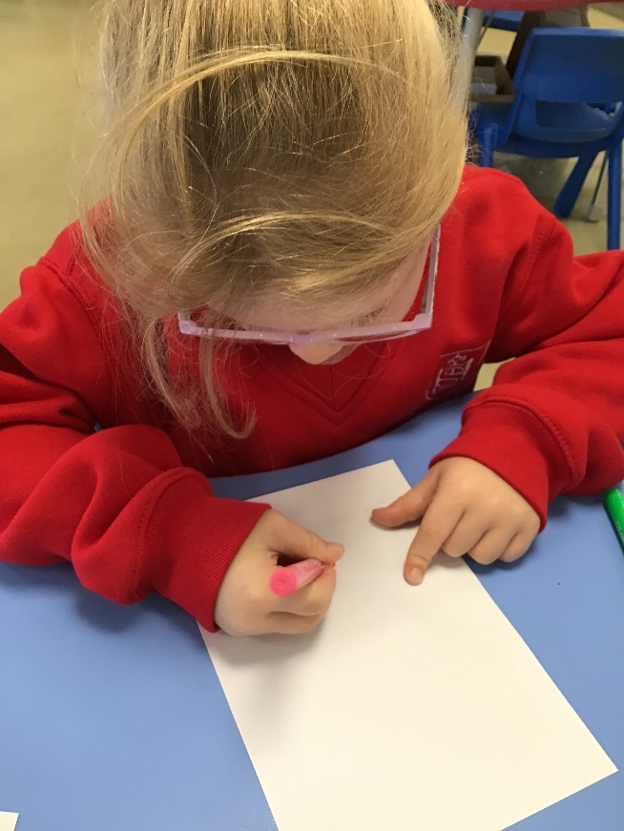

Slide 13
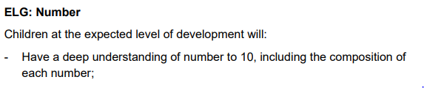
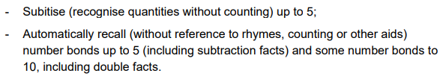
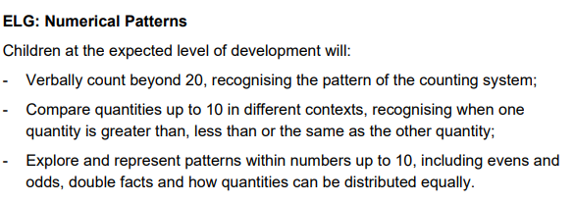
Mathematics
“Developing a strong grounding in number is essential so that all children develop the necessary building blocks to excel mathematically.”
- Statutory Framework for the Early Years Foundation Stage, 2021

Slide 14
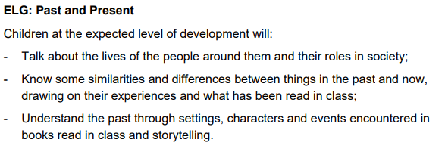
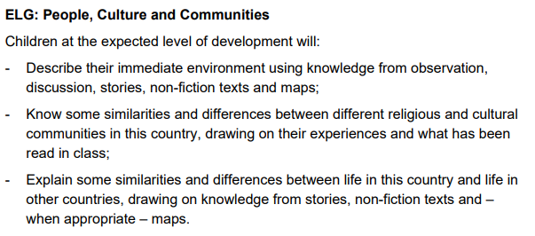
Understanding the World
“Understanding the world involves guiding children to make sense of their physical world and their community.”
- Statutory Framework for the Early Years Foundation Stage, 2021

Slide 15
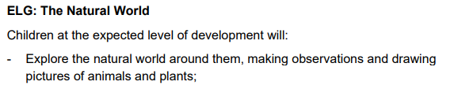
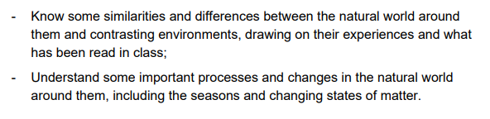
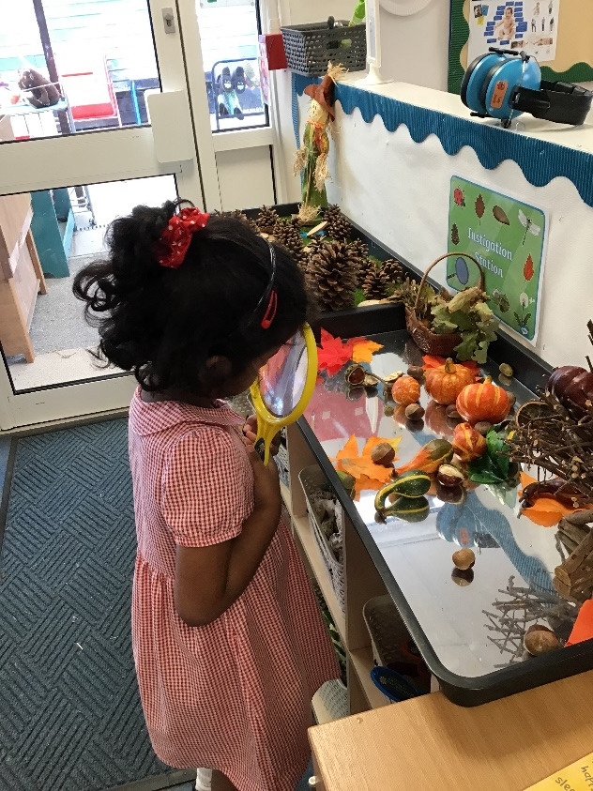

Slide 16
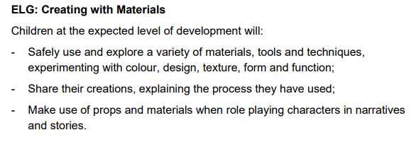
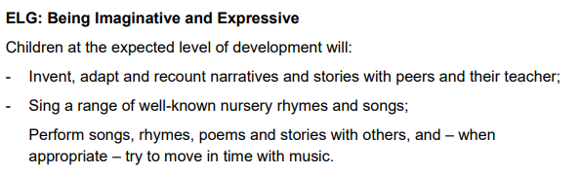
Expressive Arts and Design
“The development of children’s artistic and cultural awareness supports their imagination and creativity.”
- Statutory Framework for the Early Years Foundation Stage, 2021

Slide 17

R. E.
We are following the new R.E. curriculum.
The units are:
Creation and Covenant
Prophecy and Promise
Galilee to Jerusalem
Desert to Garden
To the ends of the Earth
Dialogue and Encounter
The children will be encouraged to talk about their own experiences and to role play lots of scenarios and bible stories.
We will also look at festivals and celebrations in other faiths.

Slide 18
Phonics
At Sacred Heart School, we follow the Letters and Sounds programme. Letters and Sounds is a phonics resource published by the Department for Education which consists of six phases.
We follow the scheme ‘Smart Kids phonics: The Code’.
During Reception we will work through phases 2-4, refining listening and attention skills and then learning the different sounds. We will have a daily phonics session.
This is to enable the children to ‘segment’ a word (sound it out) and then blend the sounds together to read the word.
There will be a phonics workshop soon to give you more information about what phonics is, how it is taught at Sacred Heart, along with some ideas of how you can support your child at home with their phonics and reading.

Slide 19
Reading
Please still read to your child, too!
When the children have settled, they will
come home with a reading book.
The children will begin with picture books.
This is a crucial stage in learning to read.
Please take time to share the book with your child, talking to them about the pictures. Once the children gain more confidence with phonics, please encourage them to have a go at ‘sounding out’ the words themselves.
When you have shared a book with your
child please make a comment and
sign the Reading record.
You will also find a list of ‘tricky words’ to practice.
Children will be read with and have their books changed on Fridays.

Slide 20


Slide 21
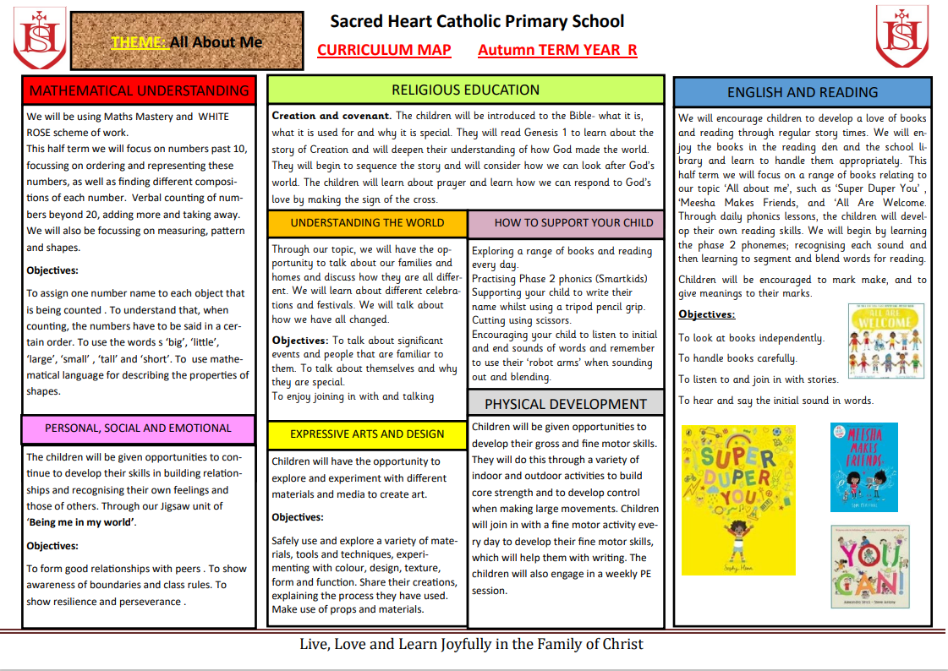

Slide 22
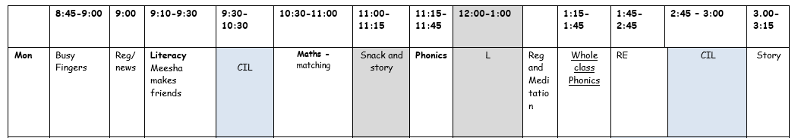
Our daily routine
RE consists of carpet input lessons and carousel activities (2 ½ hours a week)
Our PE lessons will be on a Thursday afternoon.
CIL- Child Initiated Learning. This is where the children have the chance to learn through play.
Children will start attending assembly after Christmas.

Slide 23
Home Links
The children will come home with a reading record and reading book in their book bags.
If you need to contact us regarding your child’s learning, please write in your child's reading record or make an appointment with the office.
Your support at home is warmly welcomed to reinforce your child’s learning and development.

Slide 24
What can you do at home?
Practise getting changed.
Encourage independence when getting things ready for school.
Recognising and writing name.
Board games
Card games
Go to the park
Fine motor skills.
Reading.

Slide 25
Assessment
Each week, we make observations of the children in the learning environment- outlining the skills we observe and any next steps that we will help the children to develop.
We use these to develop a ‘Learning Journal’ for each child.
We have just a new system for observations, more information to follow.

Slide 26
Baseline Assessment
The Reception baseline is an assessment of children's skills as they begin their reception year.
As of September 2021, it became a statutory assessment as part of the EYFS framework.
This has been completed. This will inform our planning.

Slide 27
Trips
We will be visiting Ware Library during our time in Reception, parents and carers will be welcome to join us.
In June we will be visiting The Sealife Centre in Southend.

Slide 28
Things to remember
Please ensure…
All items of clothing are labelled with your child’s name.
Welly boots are in school
You read daily with your child at home and make a comment or sign the reading record each time.
PE kits are kept at school and will be sent home at the end of each half term.
Your child has a named and filled water bottle.
Book bags are brought into school every day.
Your child has suitable clothing including outerwear as we will be learning outside whatever the weather!

Slide 29
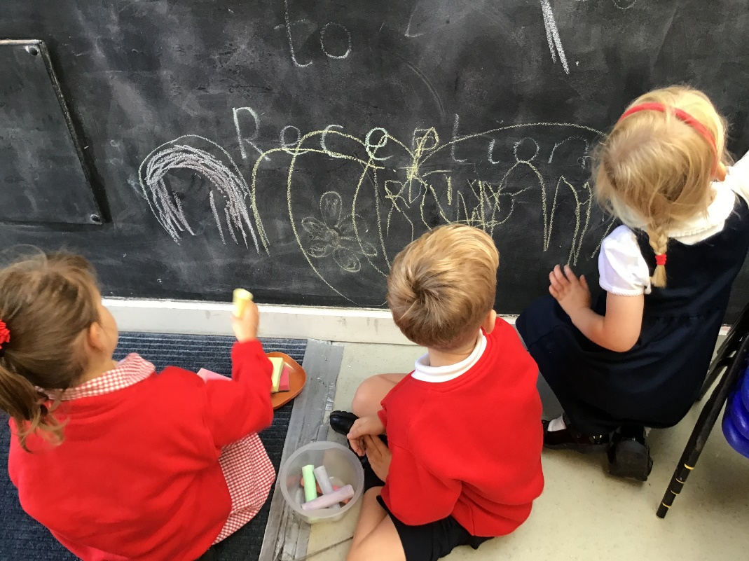
Finally
We look forward to working with you and your child in the year ahead.
Thank you for your support.

