Slide 1
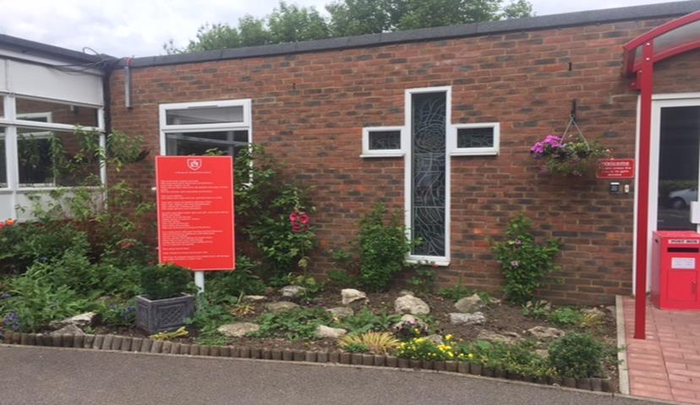
RSE Parent Presentation
Tuesday 13th June

Slide 2
Purpose
To explain what ‘Relationships and sex education’(RSE) is
To outline the school’s approach.
To explain what will be taught and when
To share resources
To answer your questions

Slide 3
Relationships education
The focus in primary school should be on teaching the fundamental building blocks and characteristics of positive relationships, with particular reference to friendships, family relationships, and relationships with other children and with adults. Relationship education is compulsory.
The main areas covered are:
Families and people who care for me
Caring friendships
Respectful relationships
Online relationships
Being safe

Slide 4
Science
In science, pupils cover and range of areas including evolution, animals and living things. They observe life-cycle changes in a variety of living things, for example, plants in the vegetable garden or flower border, and animals in the local environment. Pupils find out about different types of reproduction, including sexual and asexual reproduction in plants, and sexual reproduction in animals. They might try to grow new plants from different parts of the parent plant, for example, seeds, stem and root cuttings, tubers, bulbs. They might observe changes in an animal over a period of time (for example, by hatching and rearing chicks), comparing how different animals reproduce and grow. Science is compulsory.
Areas covered:
describe the differences in the life cycles of a mammal, an amphibian, an insect and a bird
describe the life process of reproduction in some plants and animals
describe the changes as humans develop to old age.
draw a timeline to indicate stages in the growth and development of humans.
learn about the changes experienced in puberty.
research the gestation periods of other animals and comparing them with humans; by finding out and recording the length and mass of a baby as it grows
recognise that living things produce offspring of the same kind, but normally offspring vary and are not identical to their parents

Slide 5
What is RSE?
RSE is a non-compulsory part of relationship education. Relationship Education is defined as:
… lifelong learning about physical, moral and emotional development. It is about the understanding of the importance of marriage for family life, stable and loving relationships, respect, love and care.
DofE

Slide 6
What does the Government advise?
It is important that the transition phase before moving to secondary school supports pupils’ ongoing emotional and physical development effectively. The department continues to recommend therefore that all primary schools should have a sex education programme tailored to the age and the physical and emotional maturity of the pupils. It should ensure that both boys and girls are prepared for the changes that adolescence brings and – drawing on knowledge of the human life cycle set out in the national curriculum for science - how a baby is conceived and born.
Statutory Guidance: Relationships Education 2021

Slide 7
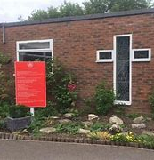
Sacred Heart’s Approach
Our Mission Statement commits us to the education of the whole child (spiritual, physical, intellectual, moral, social, cultural, emotional) and we believe that RSE is an integral part of this education. Furthermore, our school aims state that we will endeavour to raise pupils’ self-esteem, help them to grow in knowledge and understanding, recognise the value of all persons and develop caring and sensitive attitudes. It is in this context that we commit ourselves: In partnership with parents, to provide children and young people with a “positive and prudent sexual education” which is compatible with their physical, cognitive, psychological, and spiritual maturity, and rooted in a Catholic vision of education and the human person.
Notes:
Explain that policy on the website

Slide 8
What will be taught?
To know and understand:
the Church’s teaching on relationships and the nature and meaning of sexual love;
the Church’s teaching on marriage and the importance of marriage and family life;
the centrality and importance of virtue in guiding human living and loving;
the physical and psychological changes that accompany puberty;
the facts about human reproduction, how love is expressed sexually and how sexual love plays an essential and sacred role in procreation
Relationships, Health and sex Education policy

Slide 9

Sacred Heart’s Approach
Life to the Full is a fully resourced Scheme of Work in Relationships Education for Catholic primary schools which embraces and fulfils the new statutory curriculum. Taught with a spiral approach to learning, in which pupils will revisit the same topics at an age-appropriate stage through their school life, the programme includes teaching about personal health, physical and emotional wellbeing, strong emotions, private parts of the body, personal relationships, family structures, trusted adults, growing bodies, puberty, periods, life cycles, the dangers of social media, where babies come from, an understanding of the Common Good and living in the wider world. The entire teaching is underpinned with a religious understanding that our deepest identity is as a child of God - created chosen and loved by God. The programme is fully inclusive of all pupils and their families.

Slide 10
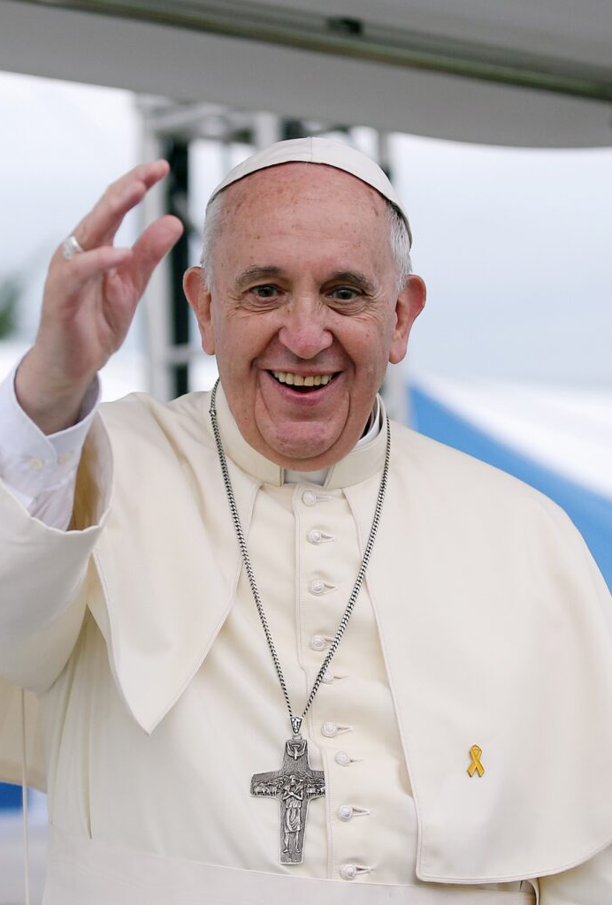
Inclusive of all families
There is no stereotype of the ideal family, but rather a challenging mosaic made up of many different realities, with all their joys, hopes and problems.
Pope Francis

Slide 11
What messages are given
Our bodies are good
We are called by God to love and be loved.
The love we share with family and friends is a reflection of God’s love.
This love develops and deepens as we get older.
We are called to love others in the wider community.
Notes:
Explain that from the foundation (left) we can then teach them the aspects of the NC and more. The curriculumfor the world they live in.(right)

Slide 12

What else is covered?
Private parts of the body.
Different kinds of family structures.
Social media.
People they can trust.
Changing and growing bodies.
Pornography.
Periods
Where babies come from
Falling in love
Physical intimacy.
Notes:
Explain that from the foundation (left) we can then teach them the aspects of the NC and more. The curriculum for the world they live in.(right)

Slide 13


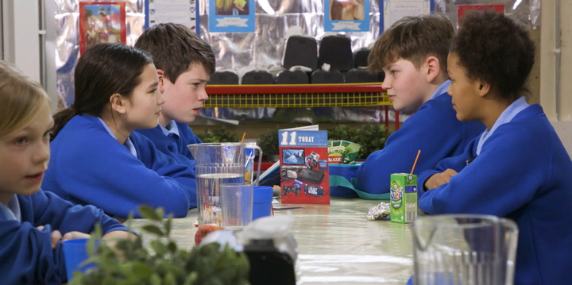
A typical session
Introduce the topic
Paradise Street
Discussion using Lucky Dip questions.
Delving Deeper video.
Activity.
Questions box in class available.
Notes:
Outline a session

Slide 14
Coverage
Year 5
Year 6
Puberty
Emotional Changes
Social Media
Menstruation
Body image
Online safety including pornography
Puberty (revisit)
Baby development
Conception.
Notes:
Roughly outline these areas

Slide 15
Next steps
Use the parent login to explore the resources. Google Ten Ten resources or click this link.
Ten Ten Resources | Catholic / Christian resources
User name ‘sacred-heart-sg12’
P/w- ‘vale-red-21’
Use this as an opportunity to talk with your child.
If wish to remove child from SRE aspects, email the school stating so.
Relationships and Science curriculum is compulsory however.
Notes:
Model log in. Model sessions, parent talk video, how to see the resources.
Discuss the opportunity to talk. Children will already know something so make sure they are being given the right messages.
User name ‘sacred-heart-sg12’
P/w- vale-red/21’

Slide 16
Making Babies 2-non-compulsary
Paradise Street is a drama exploring the lives of four Y6 children: Marcus, Layla, Siobhan and Finn who have different personal and social experiences relate to puberty.
In this episode, Finn disarms his Dad with the question, “How did your sperm actually get inside Mum’s body?” The children will learn some key information and facts about sexual intercourse; the teaching is underpinned with the religious understanding that sexual intercourse is intended for married couples and has been designed by God.

