Slide 1
Phonics Workshop

Slide 2
What is Phonics?
Phonics is a method for teaching reading and writing.
It is the teaching of reading by developing awareness of the sounds in words and the corresponding letters used to represent those sounds.
Phonics is currently the main way in which children in British primary schools are taught to read in their earliest years.
Children will also be taught other skills, such as whole-word recognition (see ‘tricky words’), book skills and a love and enjoyment of reading.

Slide 3
In school, we follow ‘The Code’. This is a DFE validated Letters and Sounds scheme which progresses through the phases, covering all sounds.
Letters and Sounds is a phonics resource published by the Department for Education and Skills which consists of six phases.

Slide 4
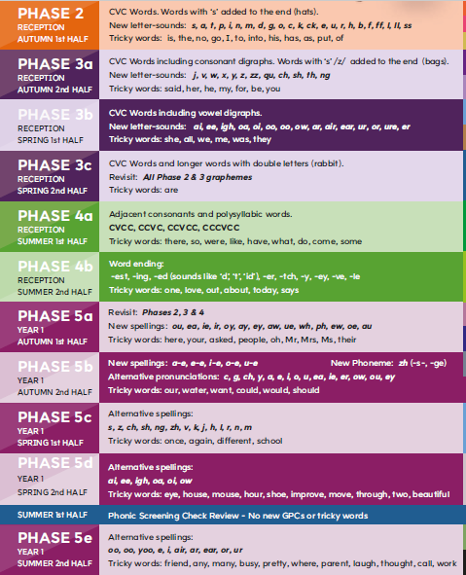
Reception
Autumn1- Phase 2
Autumn 2- Phase 3a
Spring 1- Phase 3b
Spring 2- Phase 3c
Summer 1- Phase 4a
Summer 2- Phase 4b
Year 1
Autumn1- Phase 5a
Autumn 2- Phase 5b
Spring 1- Phase 5c
Spring 2- Phase 5d
Summer 1- Revision and Phonics Screening
Summer 2- Phase 5e

Slide 5
Terminology
Phoneme
Any one of the 44 sounds which make up words in the English language.
A phoneme is the smallest unit of sound in a word. For example, ‘sun’ has 3 phonemes, whilst ‘chair’ only has 2- ‘ch’ and ‘air’.
Graphemes
A grapheme is the written form of the phoneme (sound).
Segmenting
Breaking a word into its individual sounds, for example ‘f-r-o-g’.
Blending
Putting the sounds back together again for reading. ‘f-r-o-g…frog’.

Slide 6
Terminology
Digraph
This is when two letters come together to make a phoneme- ‘ck’, ‘ll’, ‘ai’.
There are consonant digraphs- ‘sh’, ‘th’.
There are vowel digraphs- ‘ai’ ‘ee’.
Trigraph
This is when three letters come together to make one phoneme, for example ‘igh’.
Split digraph
A digraph in which the two letters are not adjacent – e.g. make
Abbreviations
VC words – Words made up of a vowel and a consonant, e.g. ‘am’.
CVC – Words made up of a Consonant, Vowel, Consonant, e.g. ‘Sam’ or ‘ship’.
CCVC –Words made up of Consonant, Consonant, Vowel, Consonant, e.g. ‘bleach’ and ‘trip’.

Slide 7
Terminology
Decodable words
These are words that you can ‘sound out’.
Tricky words/ Sight words
These are words that are not decodable. Children need to learn these by sight. Each phase has a set of tricky words.
High Frequency words
These are words that occur often in books.

Slide 8
What does a Phonics lesson look like?
Revisit/review | Flashcards to practice phonemes learnt so far.
Teach | Teach new phoneme ‘j’
Practice | Buried treasure Jam, jig, jog, jid, jeb, jazz
Apply | Read captions: The jam is red. I have a job.

Slide 9
Phase 1
Lots of this will have been covered in Nursery.
We continue it throughout Reception, alongside teaching and learning of phase 2 and phase 3, as there are some really important aspects.
There are 7 aspects with 3 strands.
A1 – Environmental
A2 – Instrumental sounds
A3 – Body Percussion
A4 – Rhythm and rhyme
A5 – Alliteration
A6 – Voice sounds
A7 – Oral blending and segmenting.

Slide 10
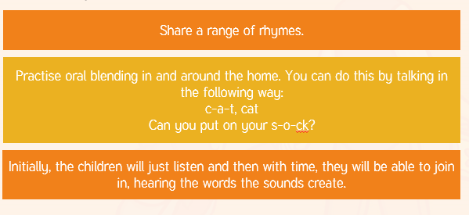
Ways that you can help at home with phase 1.

Slide 11
Phase 2
In phase 2, we begin to learn specific phonemes.
It is important that these are pronounced correctly.
If you are unsure how to pronounce the phonemes, please watch this video.

Slide 12

Phase 2
This phase builds on the oral blending and segmenting of the previous phase.
Children will be taught the grapheme-phoneme representations (letters) for the following letters.
We teach one set each week.

Slide 13
Some phase 2 decodable words
cat
c a t

Slide 14
Some phase 2 decodable words
tip
t i p

Slide 15
Some phase 2 decodable words
sock
s o ck

Slide 16
Phase 2- tricky words
is
the
no
I
go
to
into
his
has
as
put
of

Slide 17
Phase 3
In phase 3 we teach the remaining letters of the alphabet, and some sounds which are made up of 2 or 3 letters- digraphs and trigraphs.
We continue to practise segmenting and blending a wider range of CVC words.
Phase 3a | Phase 3b | Phase 3c
j, v, w, x y, z, zz, qu ch, sh, th, ng | ai, ee, igh, oa oi, oo, oo, ow ar, air, ear, ur, or, ure, er | Revisit, Review, Revise

Slide 18
Some phase 3 decodable words
jam
j a m

Slide 19
Some phase 2 decodable words
exit
e x i t

Slide 20
Some phase 3 decodable words
ship
sh i p

Slide 21
Some phase 3 decodable words
rain
r ai n

Slide 22
Phase 3- tricky words
Phase 3a | Phase 3b | Phase 3c
said her he my for be you | she all we me was they | are

Slide 23
Phase 4
This phase consolidates all the children have learnt in the previous phases.
Phase 4a | Phase 4b
Words with consonant clusters. Polysyllabic words CVCC, CCVC, CCVCC, CCCVCC | Word endings: est ing ed er tch y ey ve le

Slide 24
Phase 4- tricky words
Phase 4a | Phase 4b
there so were like have what do come some | one love out about today says

Slide 25
Phase 5
Children will be taught new graphemes. These are alternative pronunciations of previously learned graphemes.
Vowel digraphs: wh, ph, ay, ou, ie, ea, oy, ir, ue, aw, ew, oe, au
Split digraphs: a_e, e_e, i_e, o_e, u_e

Slide 26
Phase 5
Phase 5a | Phase 5b | Phase 5c | Phase 5d | Phase 5e
ou, ea, ie, ir oy, ay, ey, aw, ue, wh, ph, ew, oe, au | a-e, e-e, i-e, o-e, u-e Alternative pronunciations: c, g, ch, y, a, e, I, o, u, ea, ie, er, ow, ou, ey. | Alternative spellings: s, z, ch, sh, th, ng, zh, v, k, j, h, l, r, n, m | Alternative spellings: ai, ee, igh, oa, ow | Alternative spellings: oo, yoo, e, I, air, ear, or, ur

Slide 27
Phase 5- tricky words
Phase 5a | Phase 5b | Phase 5c | Phase 5d | Phase 5e
here your asked people oh Mr Mrs their | our water want could would should | once again different school | eye mouse house hour shoe improve move through two beautiful | friend any many busy pretty where parent laugh thought call work

Slide 28
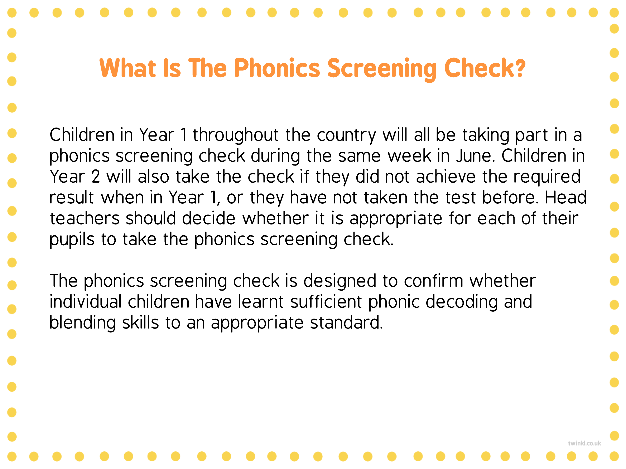
Phonics screening

Slide 29
Examples of these can be found…
http://www.oxfordphonicschecksupport.co.uk/login
We will be sending examples home
www.phonicsplay.co.uk (to help with blending real and alien words)

Slide 30
Year 2 Spelling
We use the Herts Essential spelling programme.
This spelling resource focuses on the teaching of spelling so that children understand how to apply patterns, strategies and knowledge to other words.
It also provides links to prior knowledge and tracks back to related objectives so that teachers can give targeted support.
The sequences follow the daily phonics model of Review, Teach, Practise and Apply.

Slide 31
Reading
Rec- we have story time twice a day. We will move on to Guided reading. Your child will read with an adult on a 1:1 basis every week.
Year 1-Your child will read once a week in a group with an adult at school, they will not bring this book home. They will also read with an adult on a 1:1 basis once a week.
Any reading that you do at home should be logged in the yellow homework diary
We will not write what we have read in the yellow homework diary - unless we feel there is something specific you could be practising at home.
School books should be boosted through library books and books at home. Children should also be read to, to develop language understanding.
Notes:
Karen

Slide 32
Resources and useful websites
Phonics play has some free games that we also use in class
Letters and sounds has lots of information, printable resources and games.
Top Marks has lots of games.
Our website page has some ideas for games you can make and play at home.

Slide 33
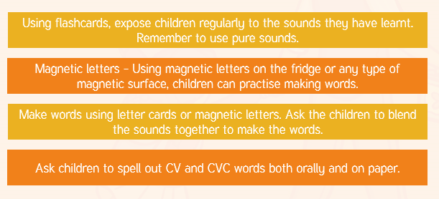
Ways that you can help at home.

Slide 34
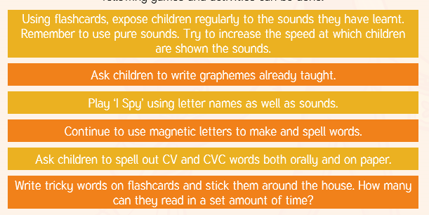
Ways that you can help at home

Slide 35
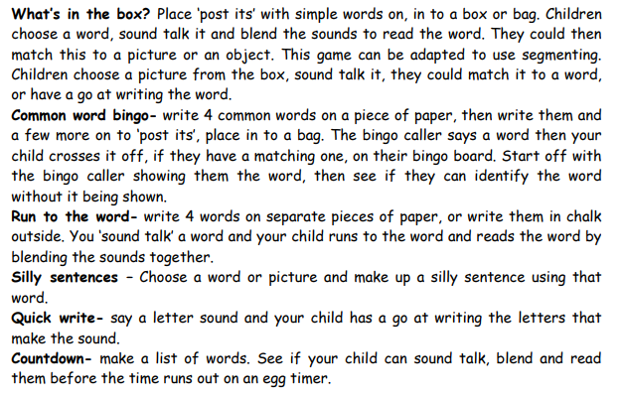
Phonics activities at home

Slide 36
