Slide 1

Year 4 residential trip
Mon 28th- Wed 30th April 2025

Slide 2
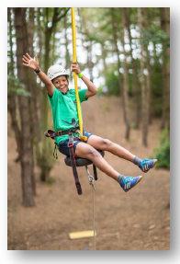
Today we will discuss:
Centre
Leaving and return times
Staffing
Activities and timetable
What to bring
Sleeping arrangement
Expectations
Questions

Slide 3
Hilltop
Three days, two nights
Located in Sheringham, Norfolk.
Range of activities, all supervised.
Accompanied by Mr McIntyre, Mrs Weller and Miss Beviss
Catered, three meals a day.
click

Slide 4

Departing and returning
Leave approx. 9am on Mon
Luggage
Packed lunch
Travel sickness?
Due to arrive at 11:00
Ready for activity.
Due to leave centre after lunch, return to school on Wednesday at 3:45
Notes:
Leave about 10.
Luggage can be brought in the morning and left on the playground (hall if wet)
Meal upon arrival will need to be provided- make it disposable- water bottle is fine though.
Once we arrive, message will be sent to school. They will contact you with updates.
Once arrived, we eat then start. They will not go to the rooms until after the first activity so need to be dressed to go.
Will message you when leave and when near school.

Slide 5
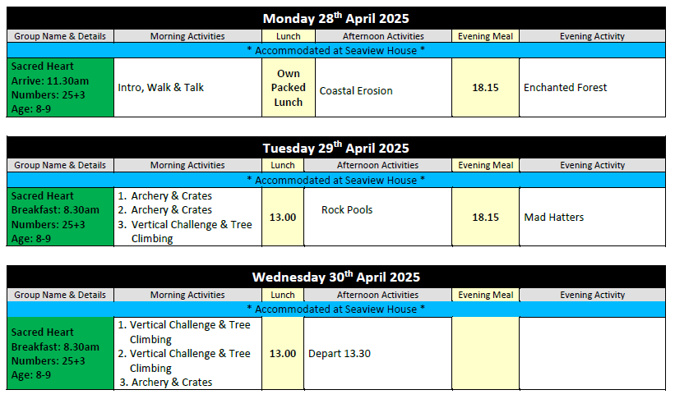
Activities

Slide 6
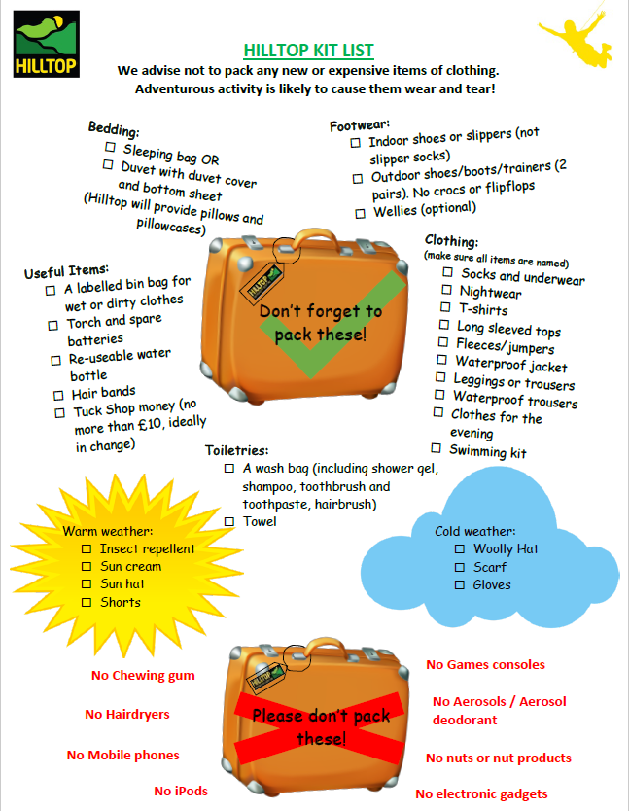
Kit
Please bring clothing that you are happy to get dirty.
Name your child’s belongings- pack with them.

Slide 7
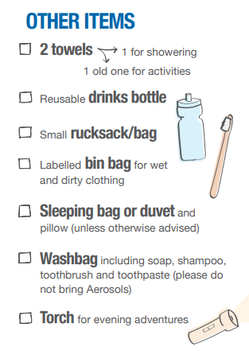
Kit
Other useful items.
Something for the bus to entertain

Slide 8
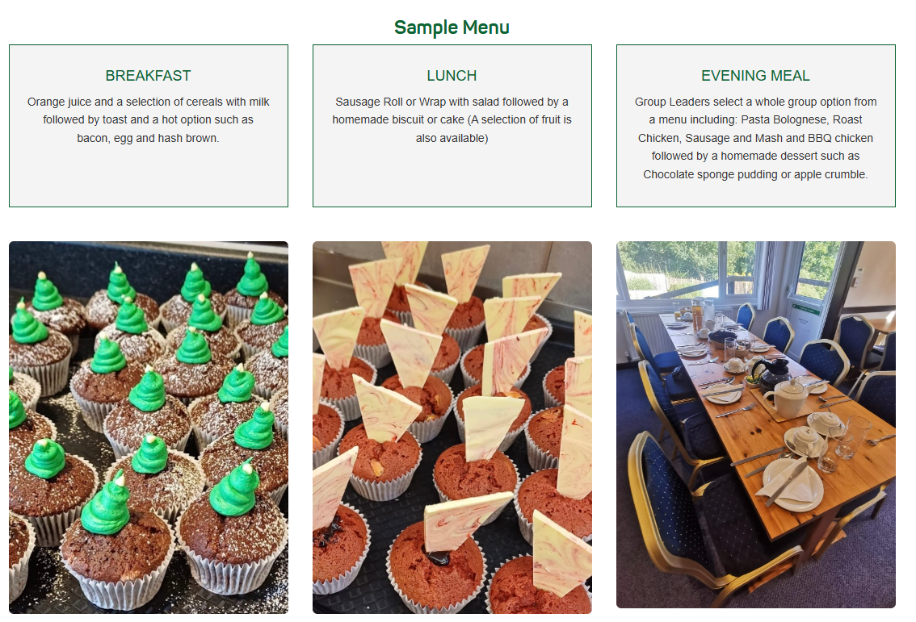
Menu
Notes:
UK PGL Menu - PGL Schools & Groups

Slide 9

Please do not bring:
Mobile phones (or Smartwatches).
Jewellery or other valuables.
Gaming devices.
Aerosols.
Sweets.

Slide 10

Money
In a labelled, bag, purse or wallet.
Max: TBC
One shop trip, try to bring change.

Slide 11

Medicine
Ensure form completed.
Make sure all medicine is in date.
Travel sickness for there and back.
Named and handed in on Monday.

Slide 12

Sleeping Arrangements
Single sex dorms (3-7 per dorm).
Teacher nearby.
Rooms allocated on arrival.
Children asked for a friend.
Bedding NOT PROVIDED
Notes:
Advise to bring sleeping bag/pillow to sleep on the mattress.

Slide 13
Contact Arrangements
During school hours :
Contact via the school office
admin@sacredheart312.Herts.sch.uk or
01920 461 678
Out of school hours:
Use the school email.
Don’t block ‘unknown number’ for these couple of days, it might be us.

Slide 14

Expectations
From us:
From the children:
Safe
Respect
Learning

Slide 15
Quick recap:
Before
Completed forms (OV7 and medical), get the things needed for the trip, name everything, pack bags with child.
On the day
Arrive normal time in own clothes ready for the first activity. Children leave bags on the playground area allocated. Hand in medicines/money etc. Be there at 9:00 if want to wave off.
While away
Relax(?), check emails or phone for messages.
Wednesday
Return at 3;45-4;15, collect child with a big hug!!
Notes:
Due to depart at 14:00 – traffic allowing

