Slide 1


Curriculum Evening
Year 4

Slide 2
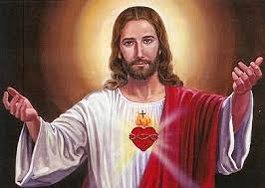
RE
Our first topic is THE BIBLE
Our second topic is TRUST IN GOD
We will have daily prayers and continue the practise of Meditation.

Slide 3



English
This year, we will be following a new scheme administered by HFL Education.
We will be using set texts to inspire writing for different purposes – to inform, to entertain and to persuade.
In Autumn 1, our texts will be “Arthur and the Golden Rope” and “The King who Banned the Dark”.
In Autumn 2, our texts will be “Until I met Dudley, “Rosie Revere, Engineer” and “Starbird”.

Slide 4



Reciprocal Reading
As well as developing their fluency, children will practise the skills of:
Clarifying vocabulary
Inferring
Predicting
Summarising

Slide 5

English - spellings
Revisiting Year 3 Programme.
Introducing the Year 4 Spellings.
Common Exception word list made available to children in lessons and on webpage.

Slide 6
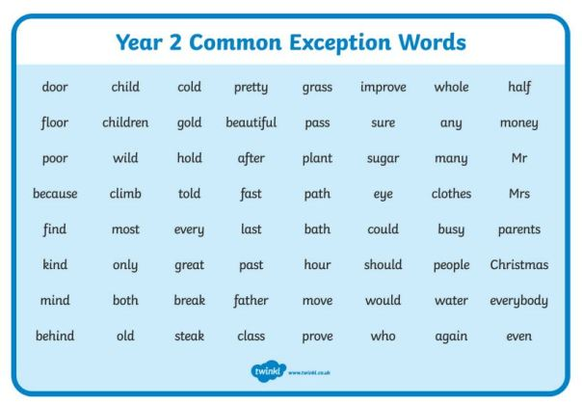
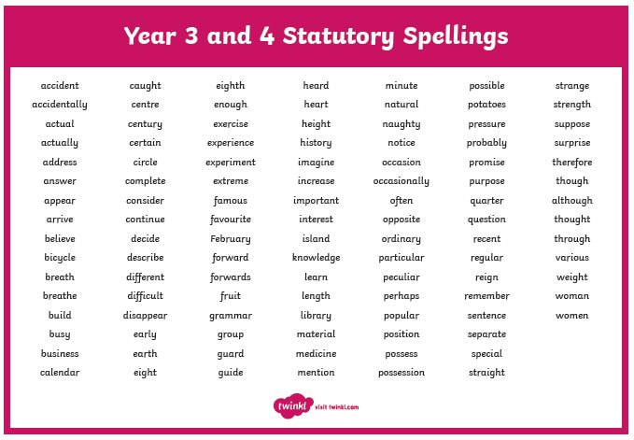
Common Exception word lists

Slide 7
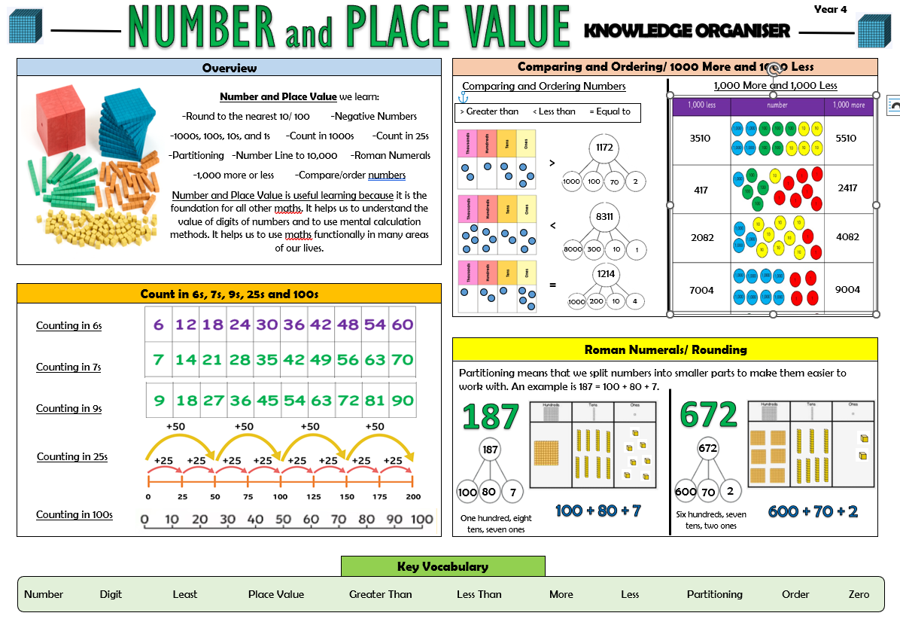
Maths
White Rose scheme of work
Revisiting some of the Year 3 curriculum.
Introducing the Year 4 curriculum.
In the Autumn term, we will work on place value and working with three-digit numbers.
We will begin to understand and use four-digit numbers.
An overview of topics will be placed on the Class Webpage, and KO’s by subject are available.

Slide 8

Times-tables Assessment
The multiplication tables check (MTC) is statutory for all year 4 pupils.
It will take place in Summer Term.
The purpose of the MTC is to determine whether pupils can recall their times tables fluently, which is essential for future success in mathematics.
In preparation for the test, we will continue learning and using our times table facts and working on our multiplication and division strategies.

Slide 9



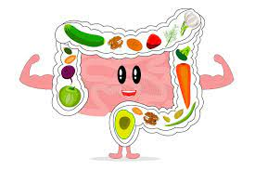

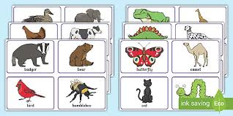
Science
Topics

Slide 10
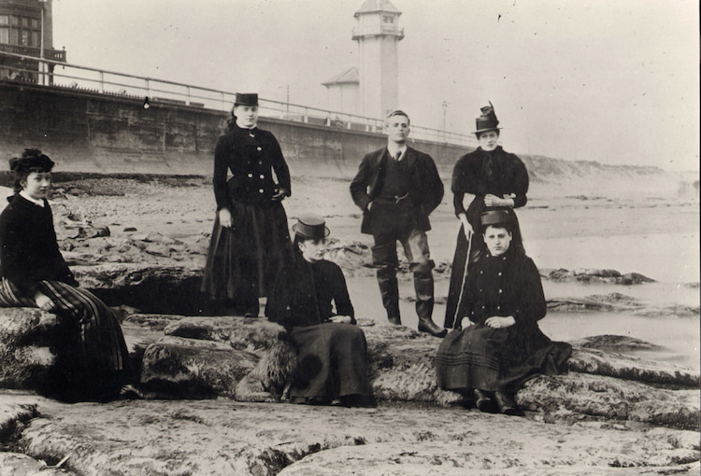
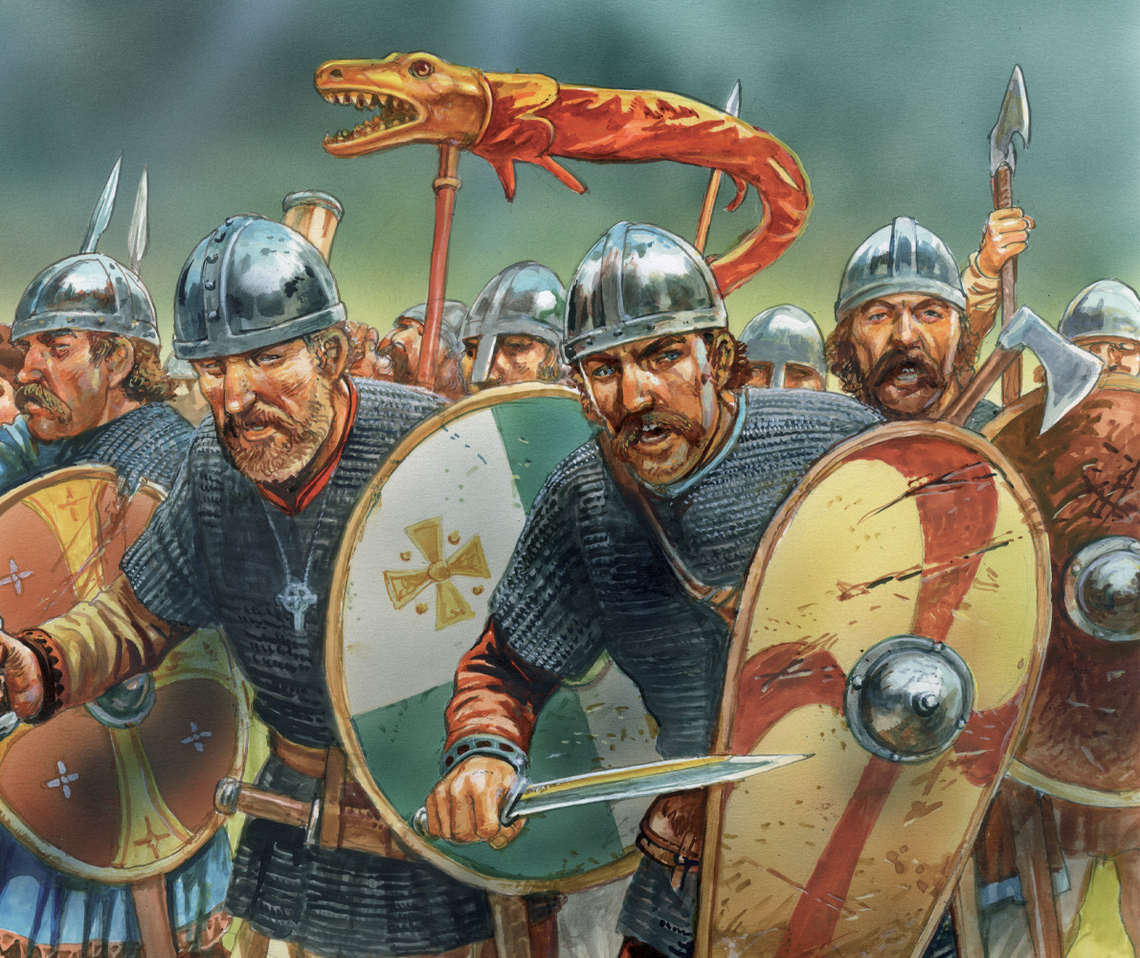
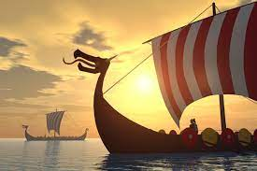
History Topics
‘Leisure and Entertainment in the 20th Century’ -
To find out about leisure and entertainment at the start of the 20th Century and consider how these pastimes have changed.
‘Invaders and Settlers’ - Through this, the children will explore how the arrival of the Anglo-Saxons and the Vikings changed the face of Britain.

Slide 11


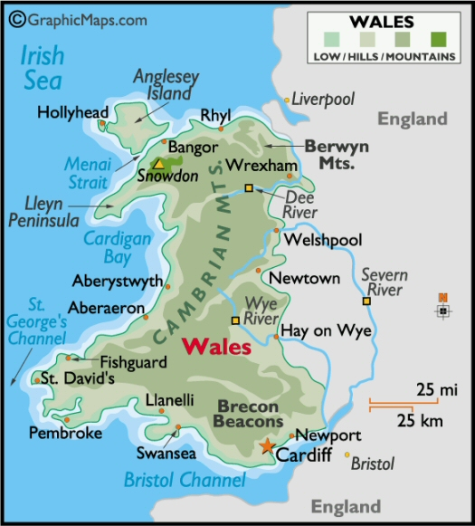
Geography Topics
‘Coasts’
‘Biomes’
‘South Wales’
Physical Features
Human Impact
Field work / skills

Slide 12

MFL
We will be learning Spanish. Years & Year 4 will have the same topics.

Slide 13



PE
PE days Monday and Friday – children to come to school in their PE kit.
Swimming will be in summer term.
22nd -24th April - residential at Hilltop (Sheringham, Norfolk). A meeting will take place nearer the time.

Slide 14

Behaviour Expectations
Sanctions:
Warnings
Restorative justice
Discussion with parents
Behaviour contract:
Decided and agreed by the class – linked to values of safety, respect and learning.
Rewards:
House Points
Gold Book
Marbles

Slide 15
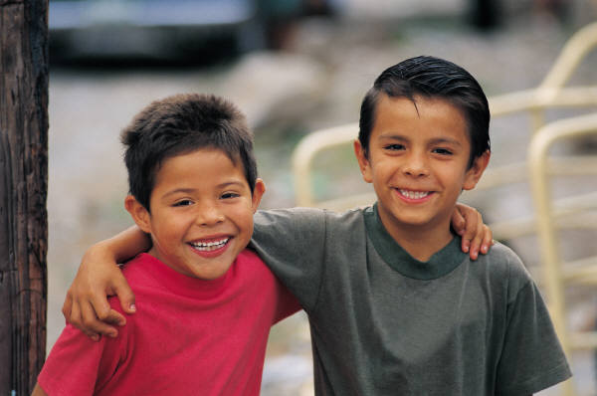
Buddy System
Year 4 will be given a buddy from the new Reception class.
They will be paired up and get a chance to read with, sit with them in special assemblies, and in the playground on certain ‘buddy events’.

Slide 16

Home learning
Children are expected to read every day.
Reading records should be written in and brought in daily.
Weekly spellings.
Times-tables practise.
2 Mathletics Activities.
Ongoing project linked to our topics.
Set on Mondays & placed on the class website.
Tests will be done Mondays/Tuesdays.

Slide 17

Thank you!
Please find curriculum letter on the website. A yearly overview will also be posted.

